Slide 1
Photos from 2016 Tenth Anniversary GDIB Launch At Forum on Workplace Inclusion March 29 to 31, 2016 Minneapolis, MN

Slide 2
1,200 attended the Forum
28 GDIB Expert Panelists and Users were on the program
• Concurrent Session Presenters
• Conversations on Race Presenters
• Plenary Panelists
• Opening Session Spoken Word Presenters

Slide 3
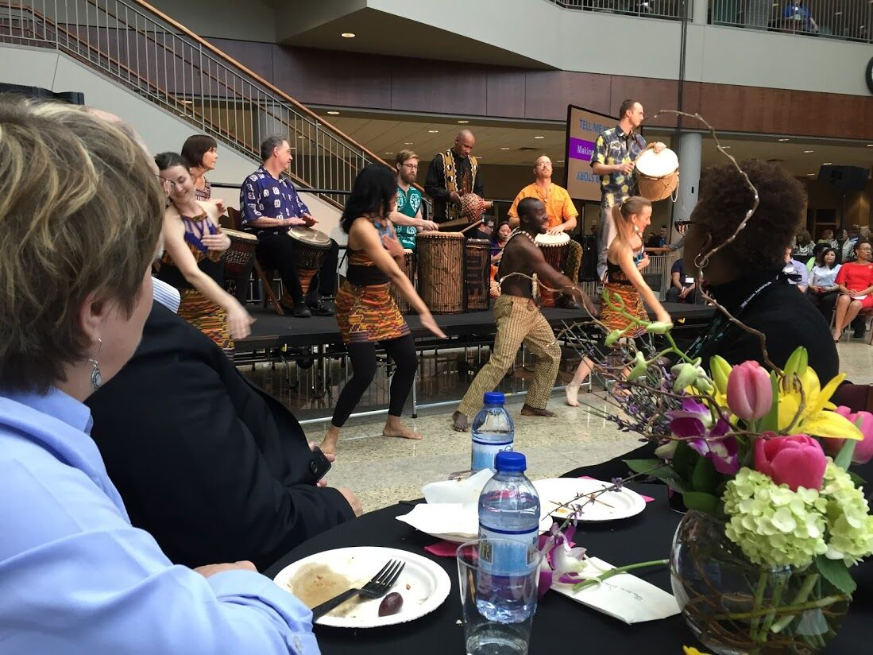

Slide 4
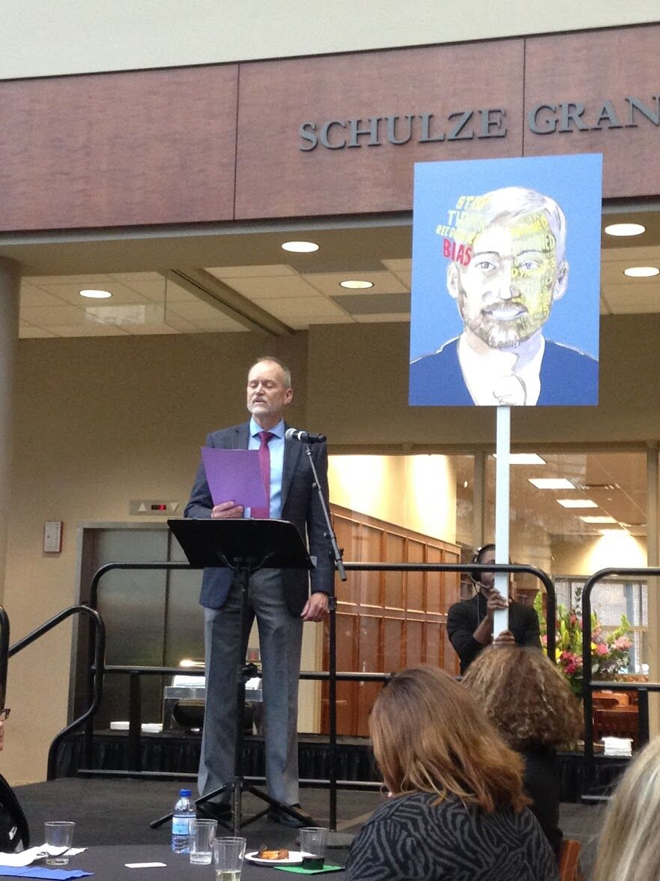

Slide 5
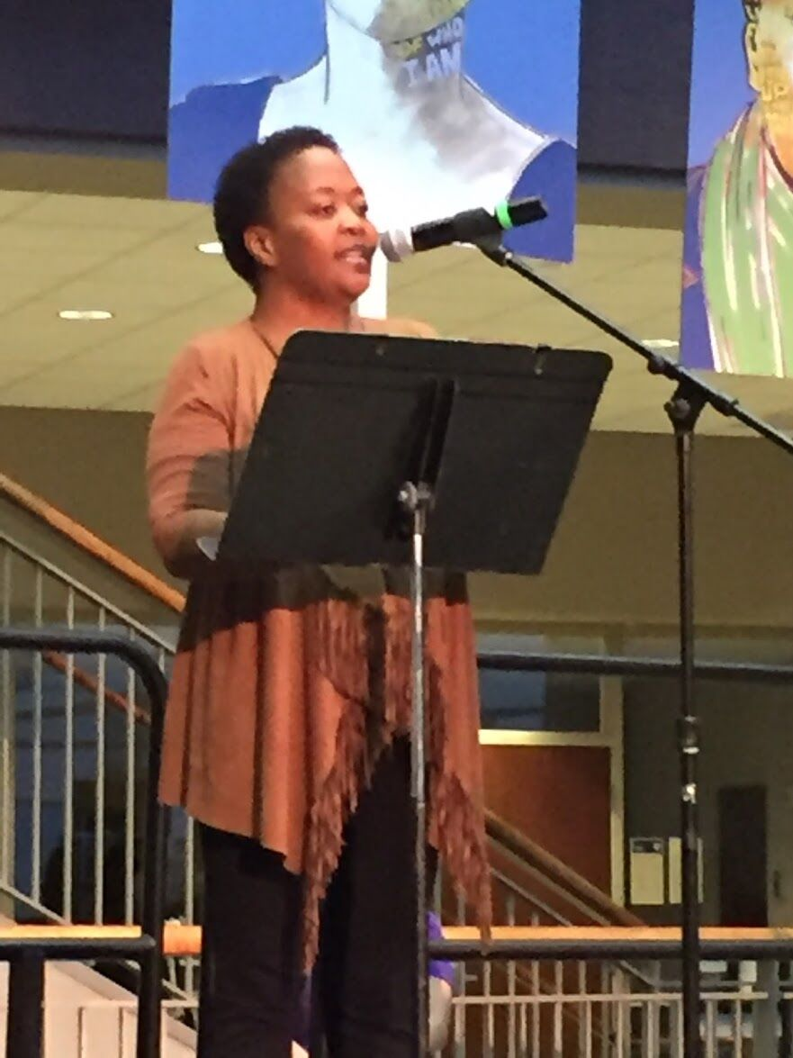

Slide 6
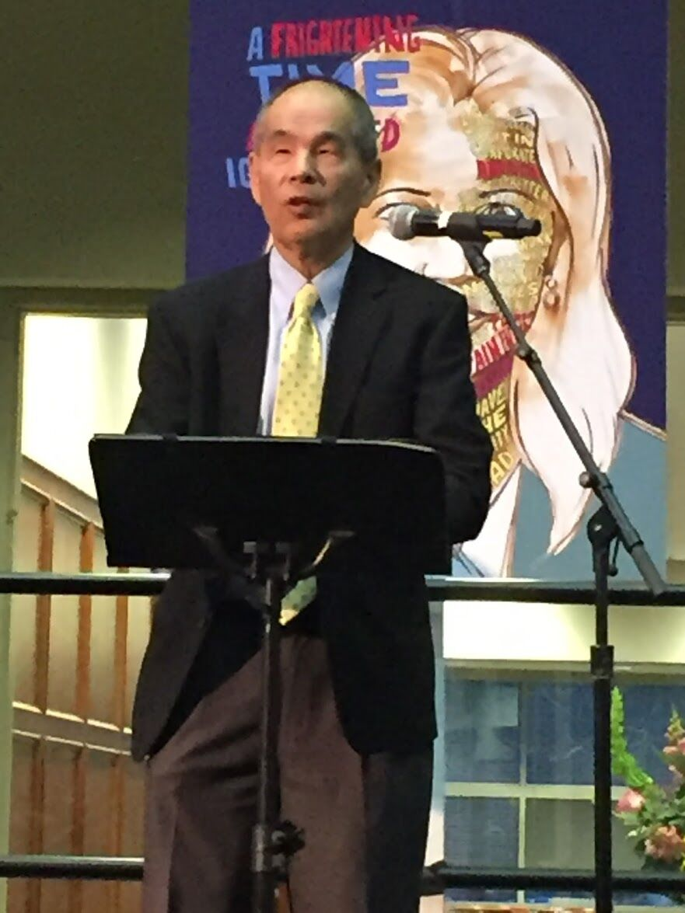

Slide 7
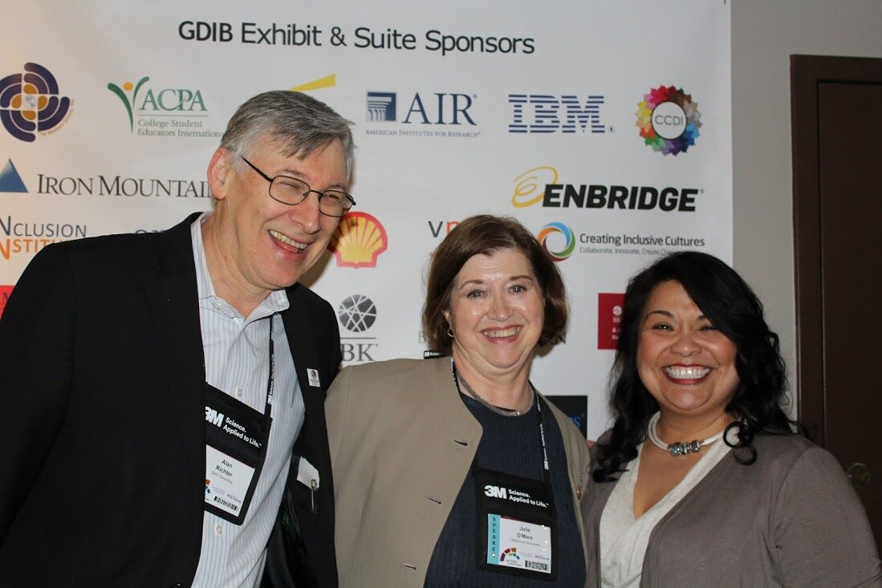

Slide 8
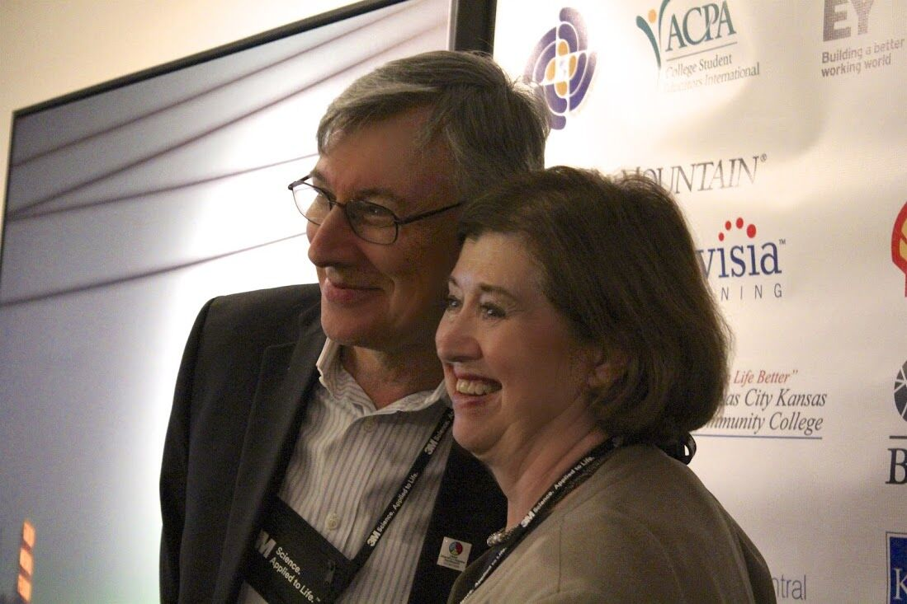

Slide 9
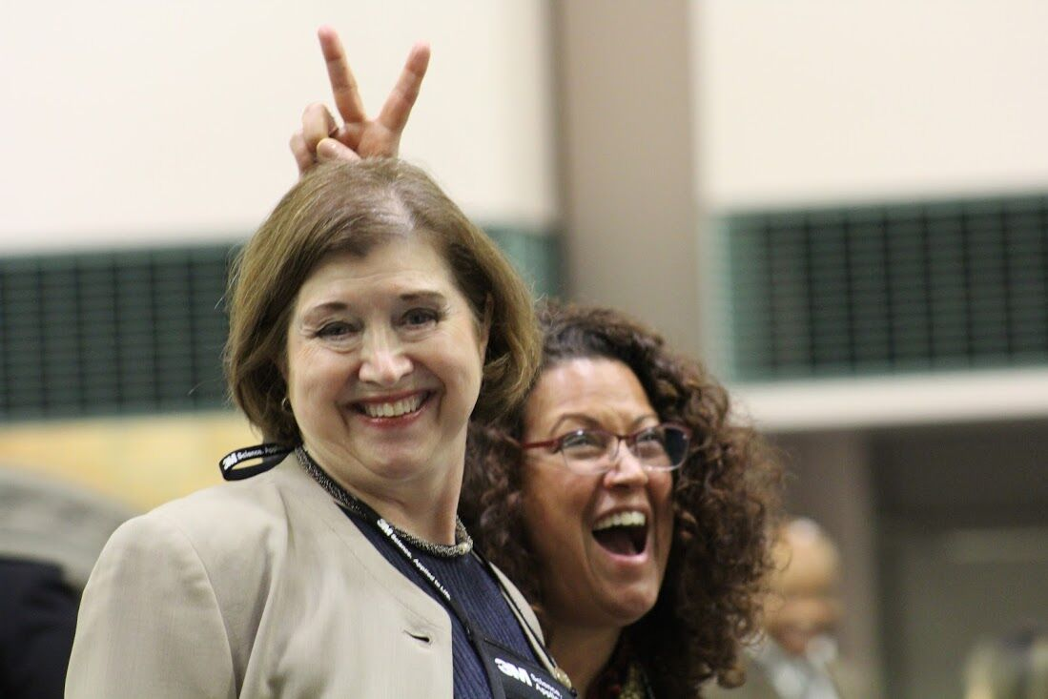

Slide 12
The GDIB Exhibit

Slide 13
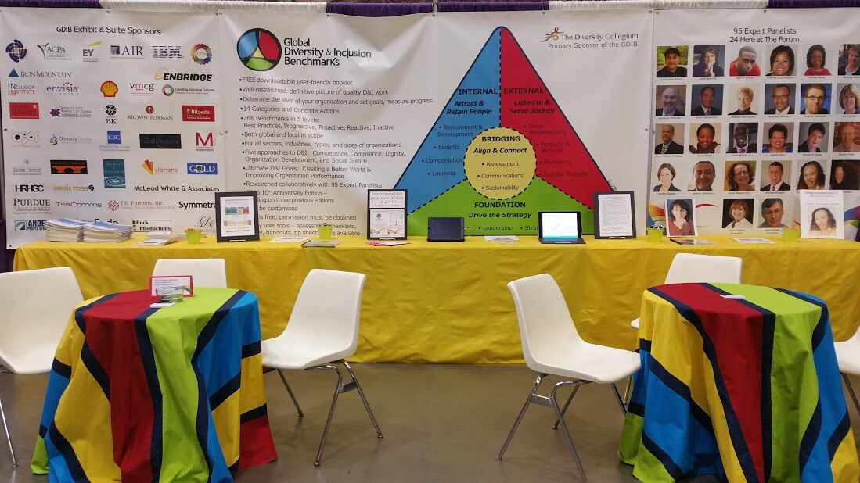

Slide 14
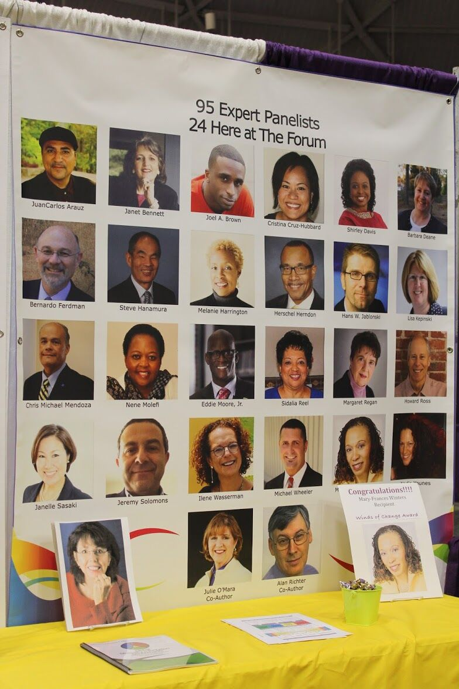

Slide 17
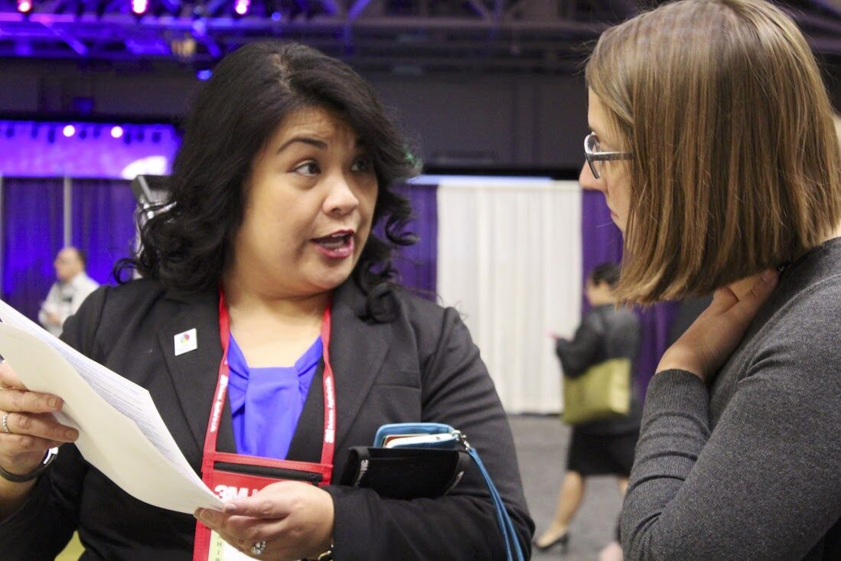

Slide 18
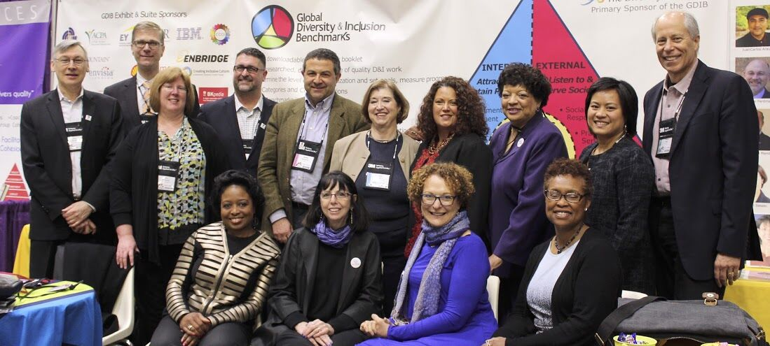

Slide 20
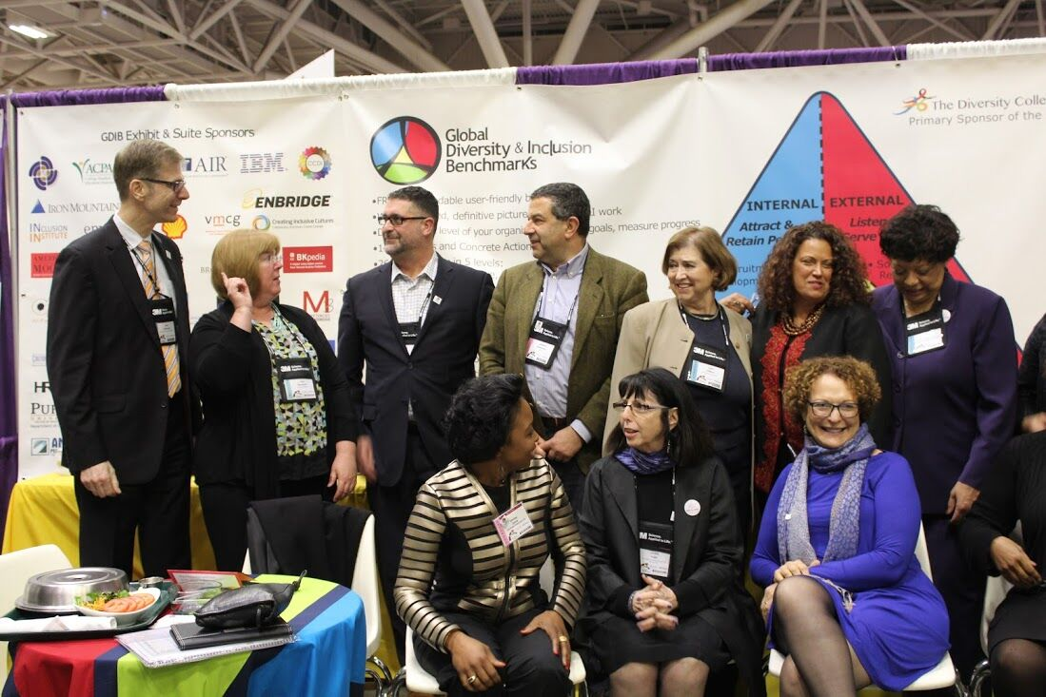

Slide 21
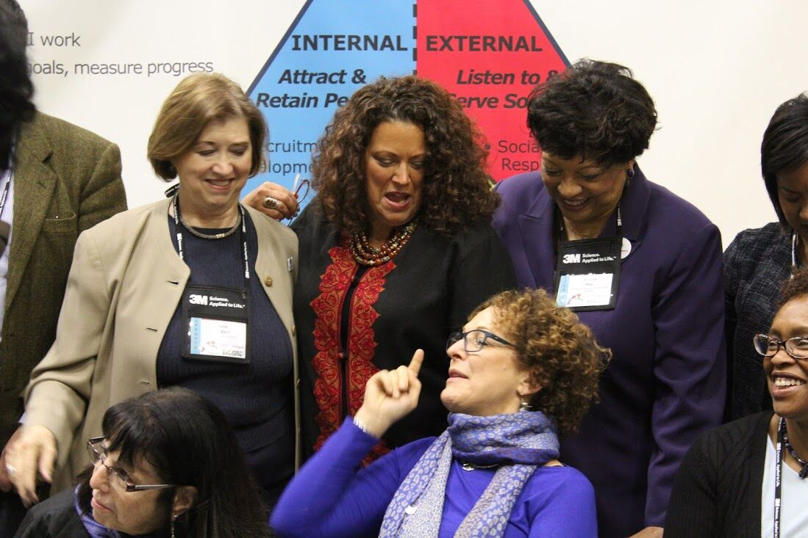

Slide 22
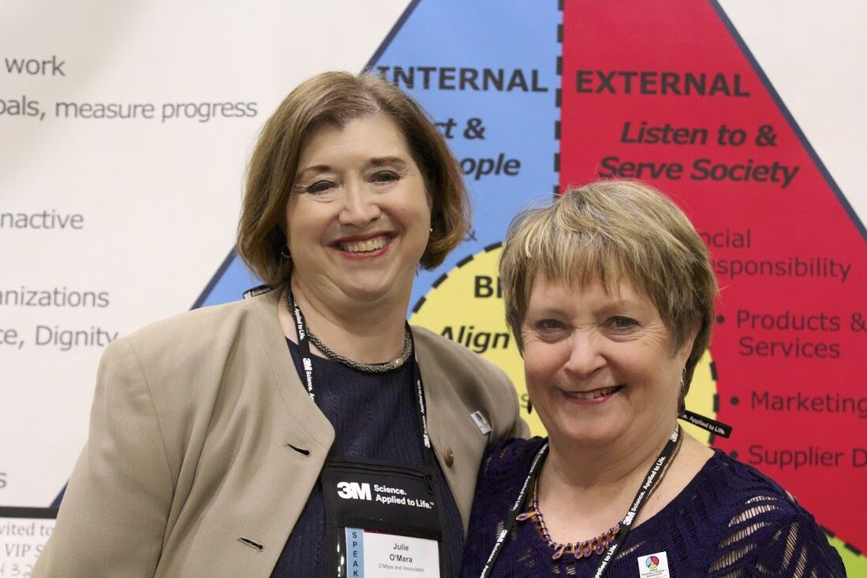

Slide 23
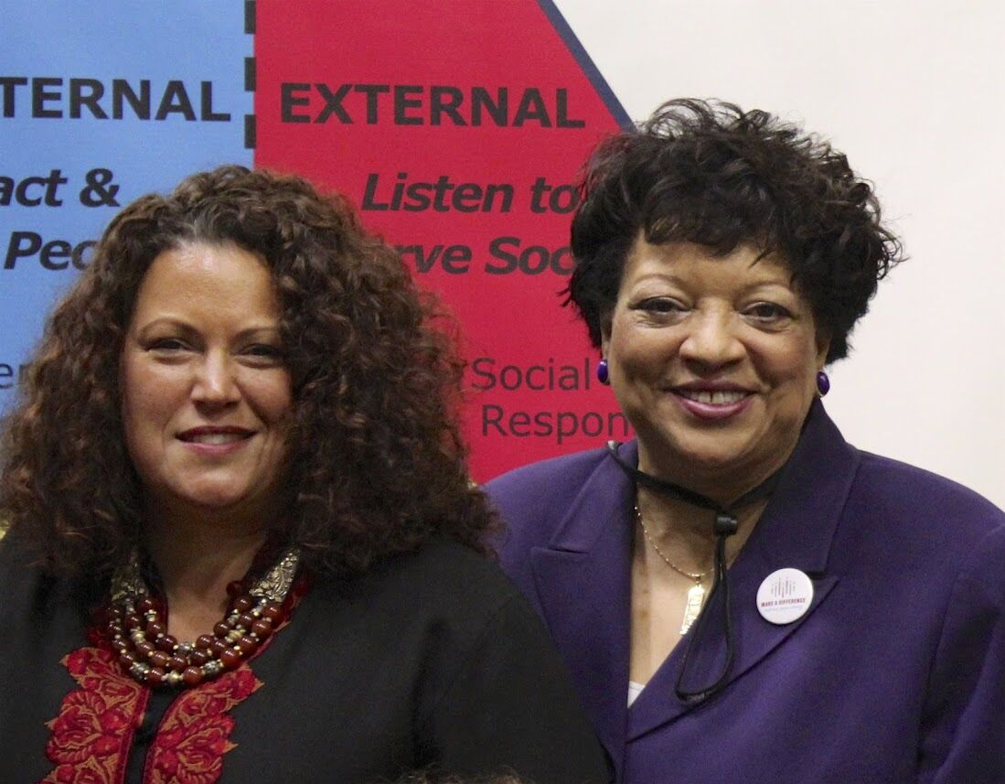

Slide 25
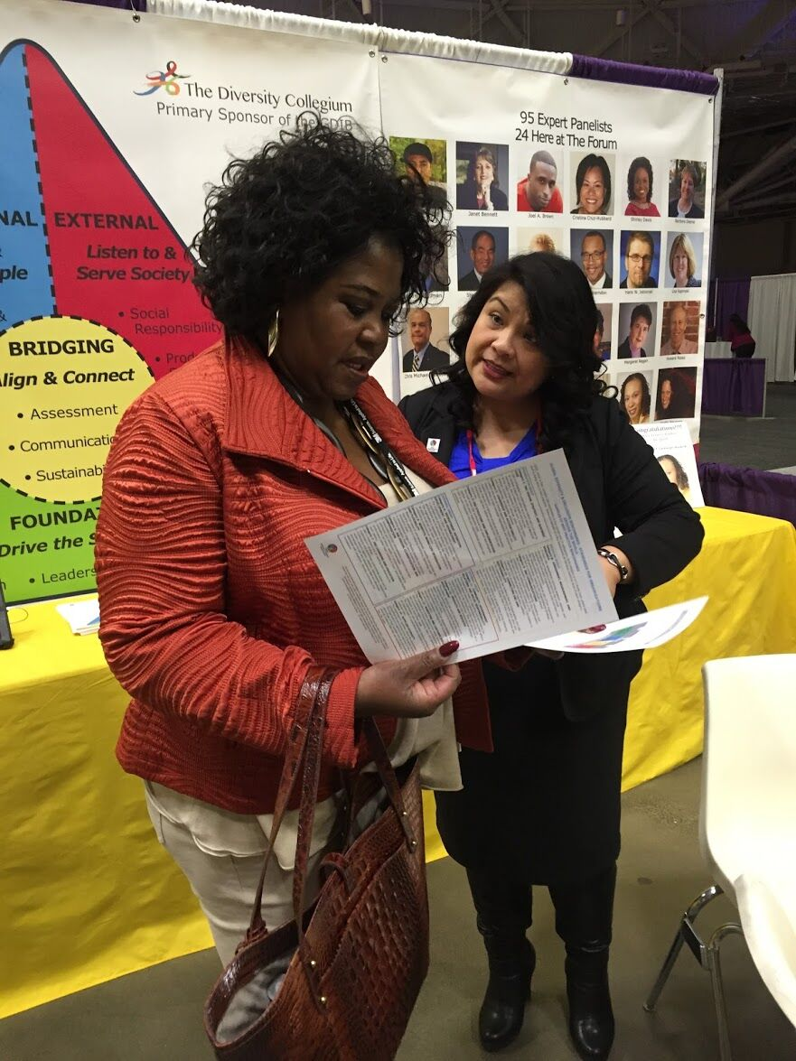

Slide 26
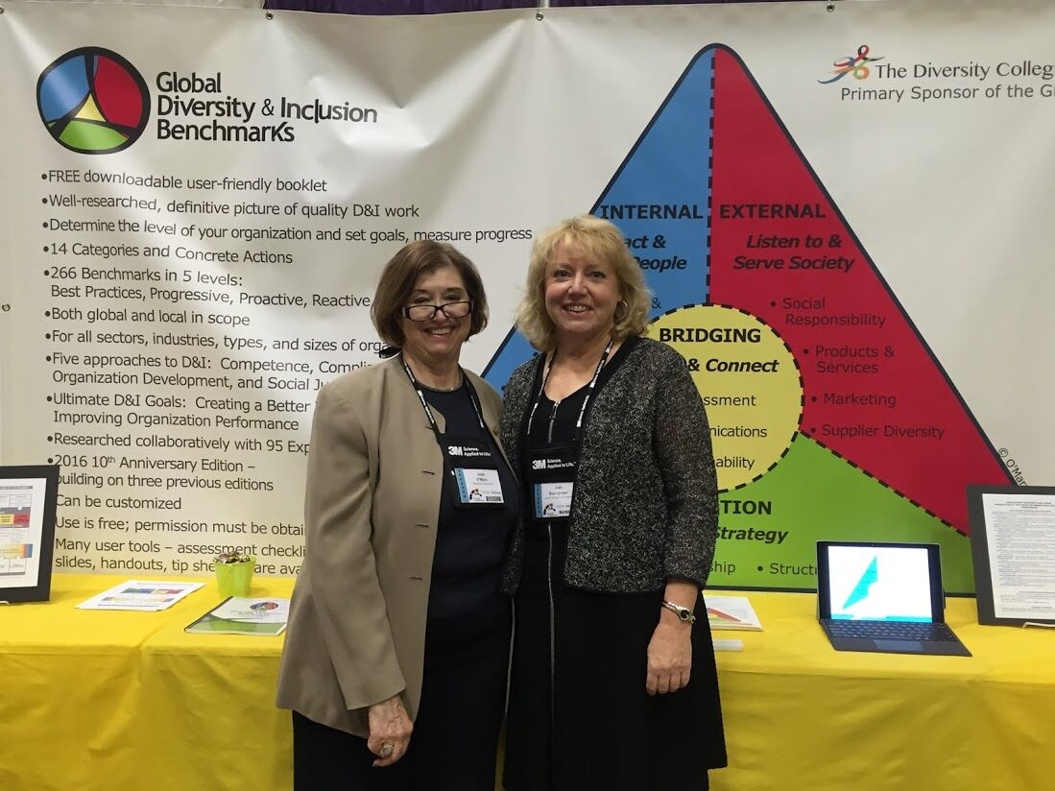

Slide 28
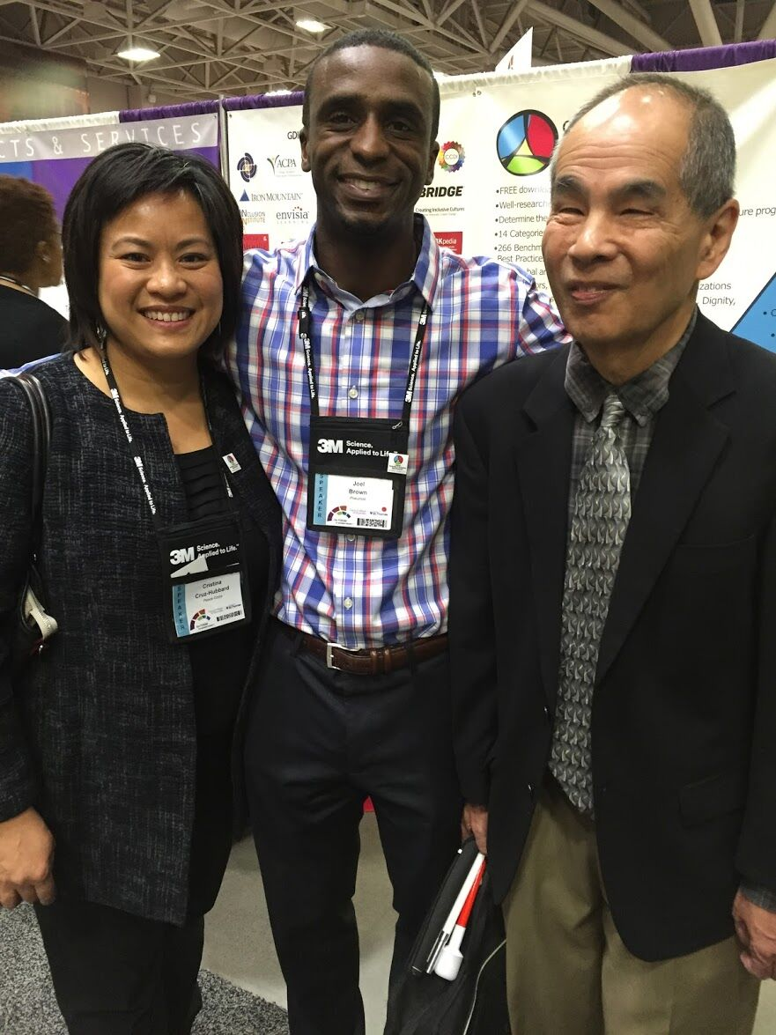

Slide 29
28 GDIB Expert Panelists & Users presented

Slide 30
28 GDIB Expert Panelists and Users
Janet Bennett
Joel Brown
Joan Buccigrossi
Joe Cordero
Tina Cruz-Hubbard
Shirley Davis
Barbara Deane
Bernardo Ferdman
Steve Hanamura
Melanie Harrington
Hans Jablonski
Judith Katz
Lisa Kepinski
Nene Molefi
more …

Slide 31
28 GDIB Expert Panelists and Users
Eddie Moore, Jr.
Julie O’Mara
Sidalia Reel
Margaret Regan
Alan Richter
Howard Ross
Riikka Salonen
Janelle Sasaki
Jeremy Solomons
Radhika Vaidyanathan
Ilene Wasserman
Michael Wheeler
Mary-Frances Winters
Nadia Younes
…and Bev Kaye’s work represented with two colleagues presenting

Slide 32
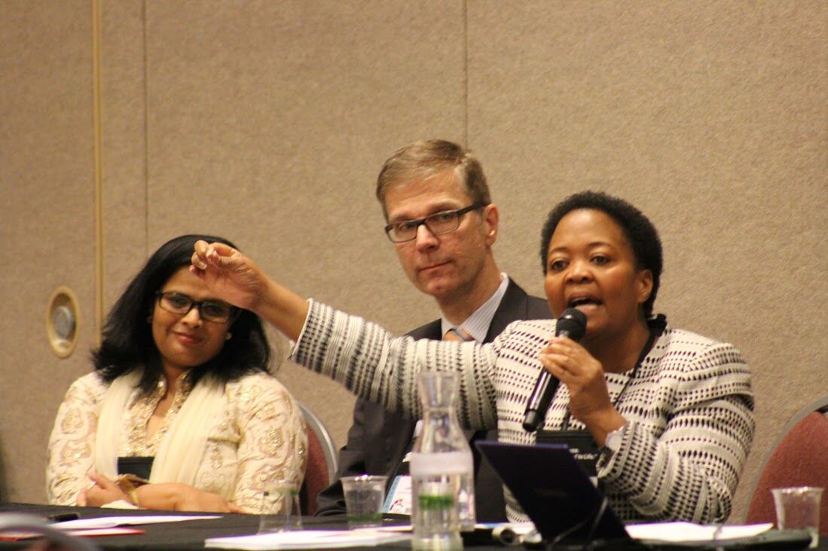

Slide 34
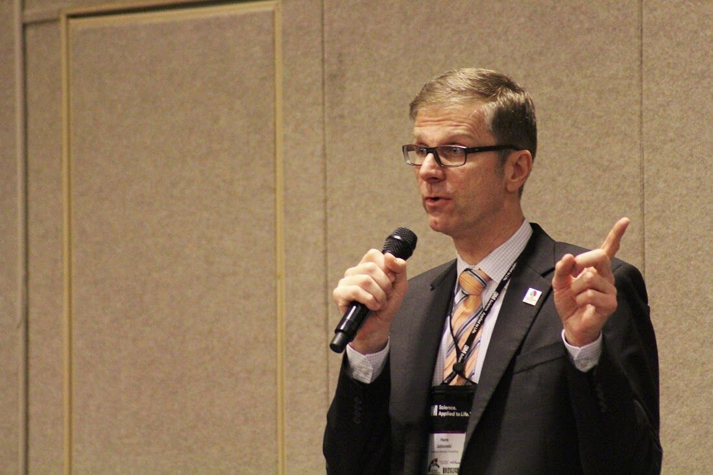

Slide 35
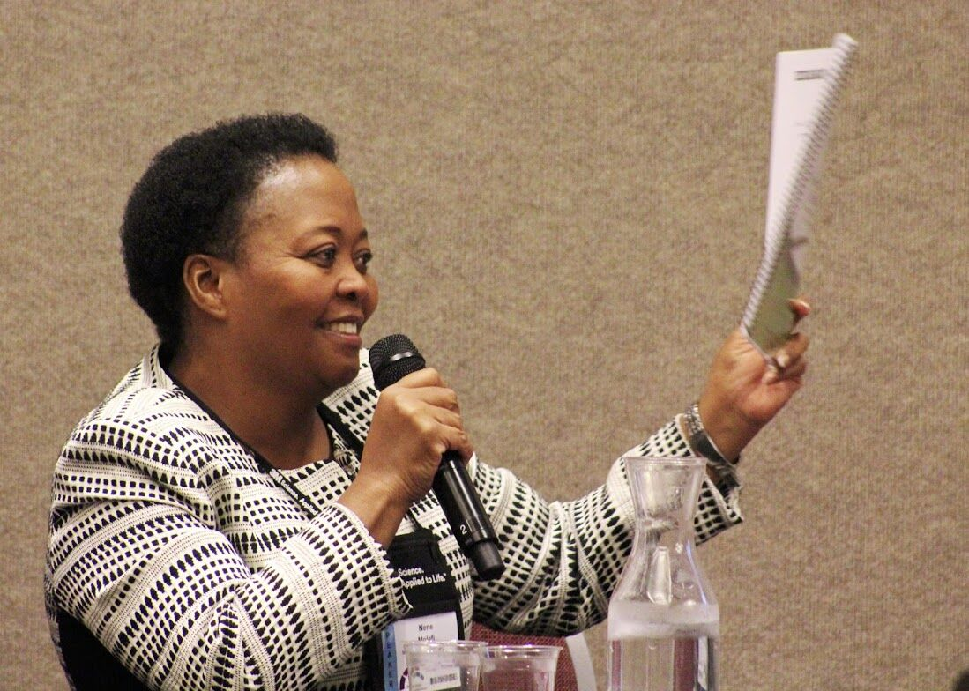

Slide 36
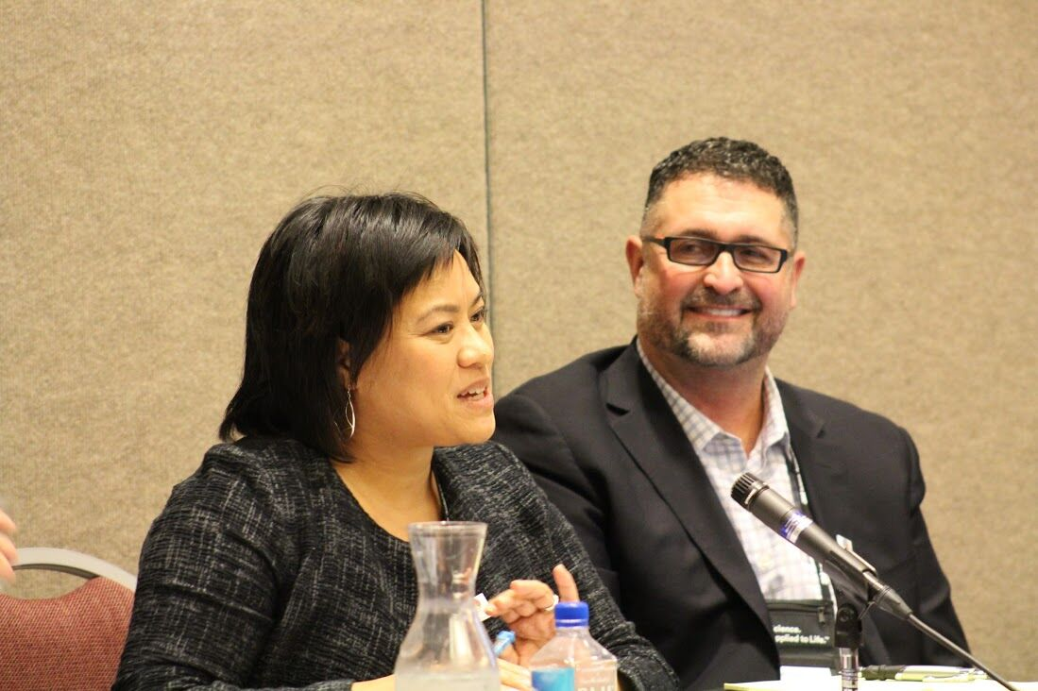

Slide 37
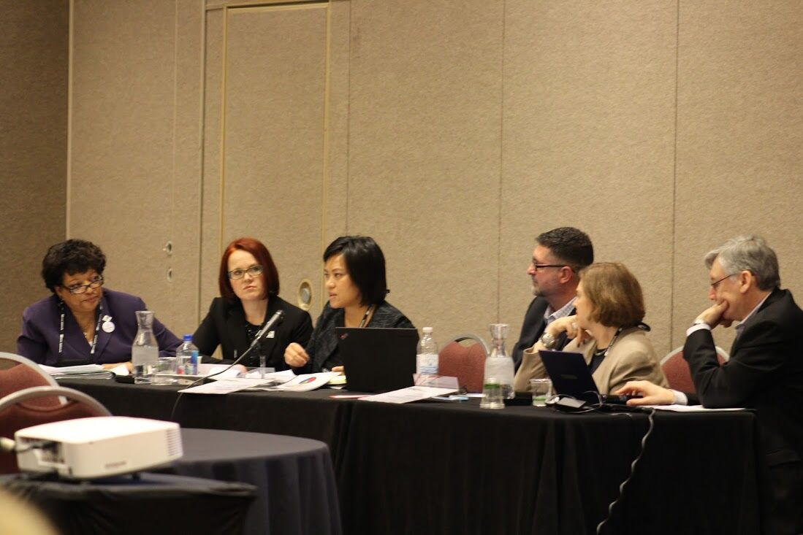

Slide 38
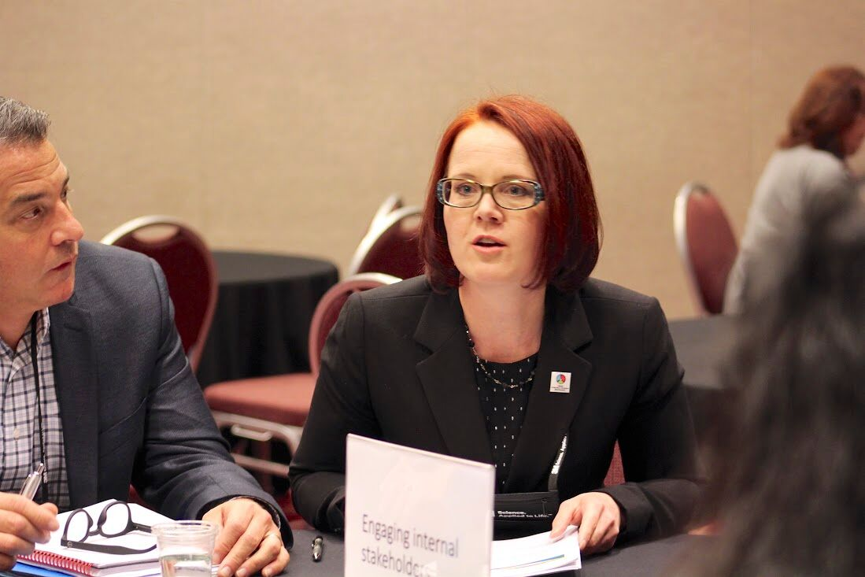

Slide 39
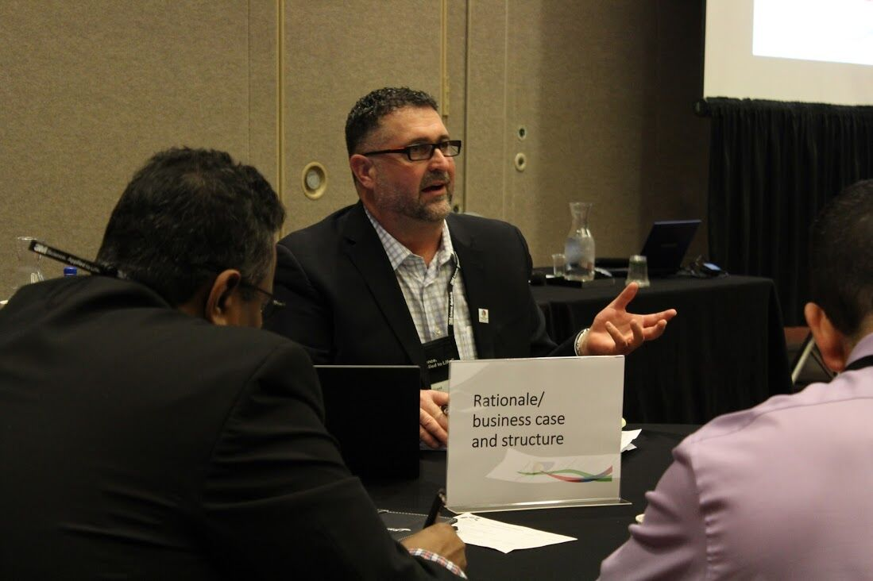

Slide 40
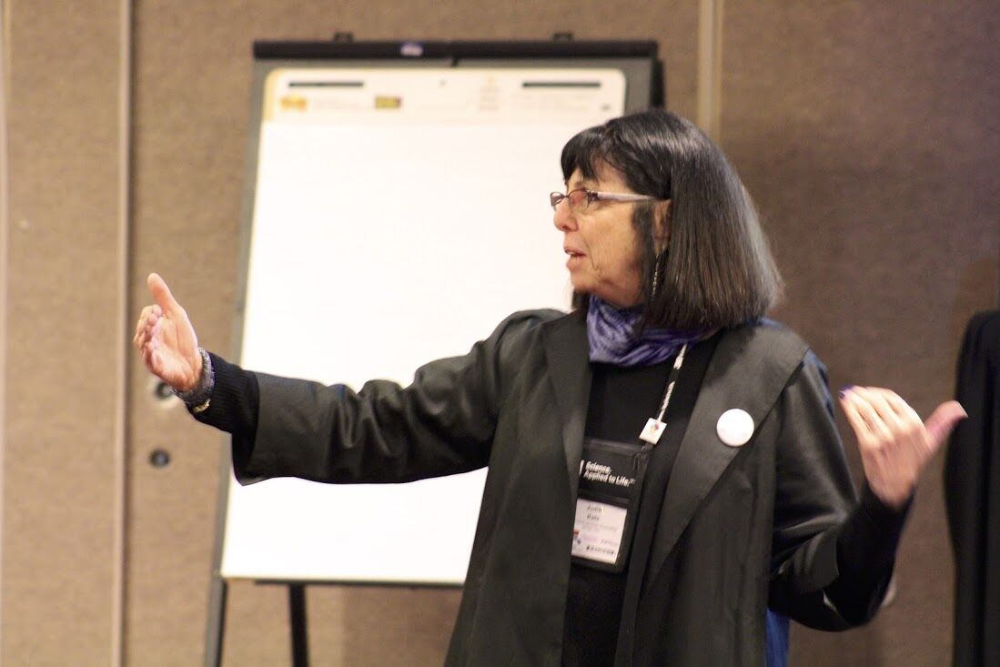

Slide 41
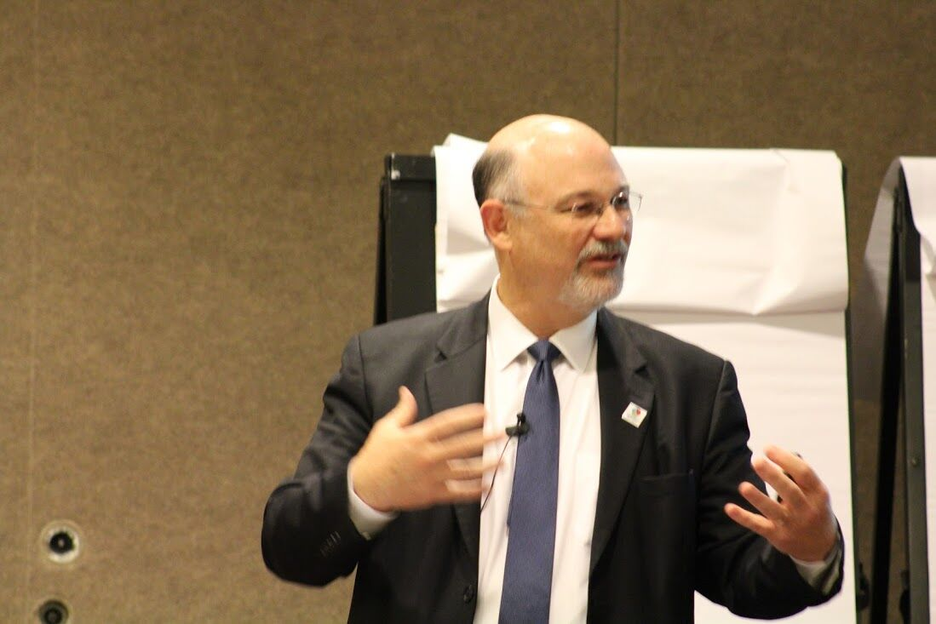

Slide 43
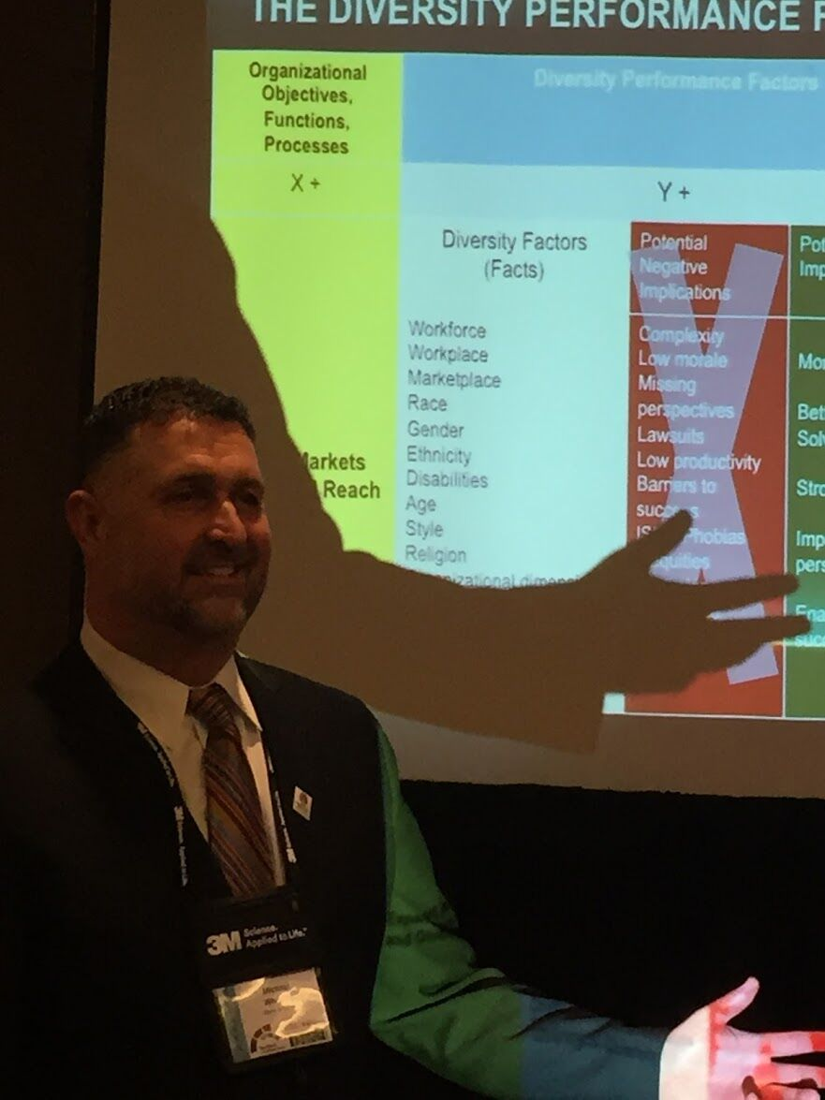

Slide 44
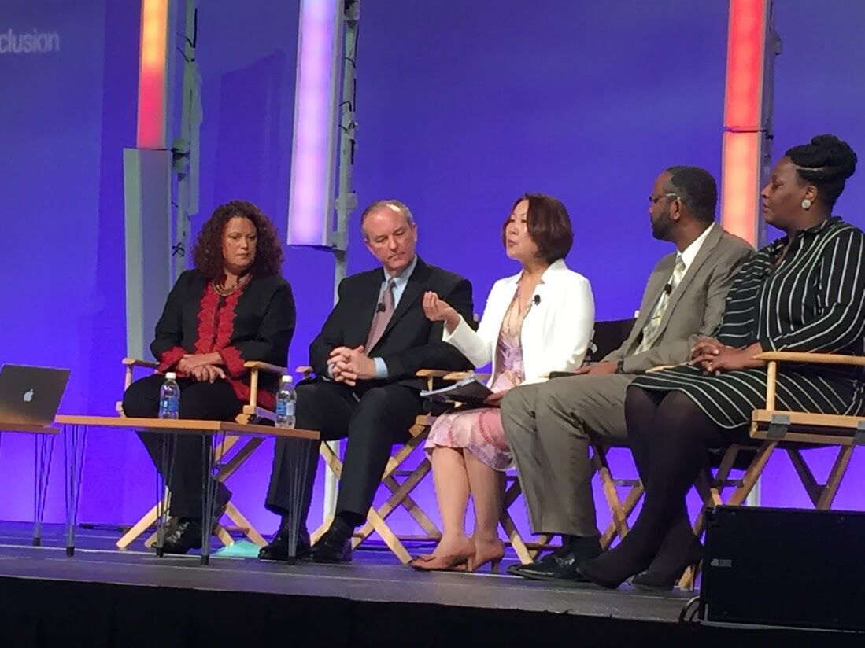

Slide 45
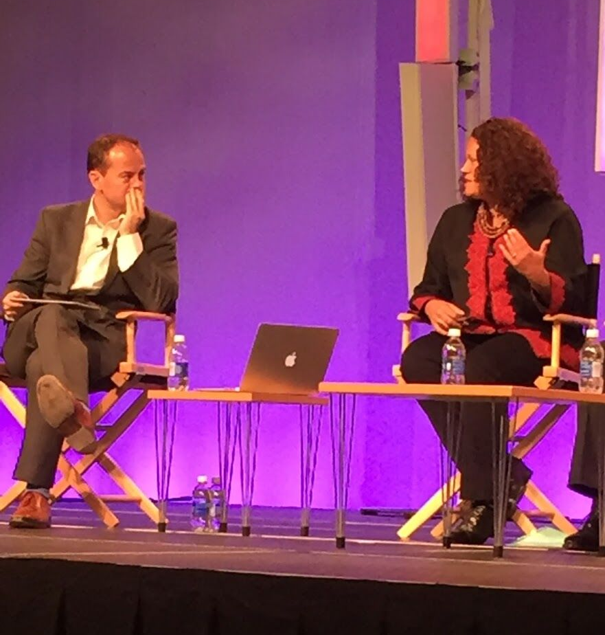

Slide 46
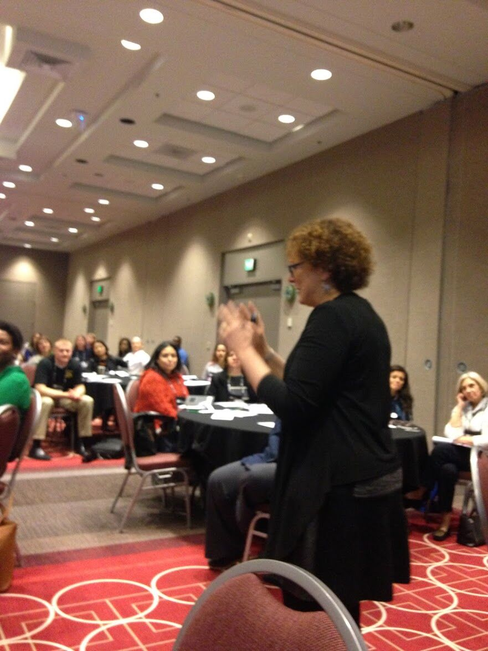

Slide 47
Celebration Suite Party

Slide 50
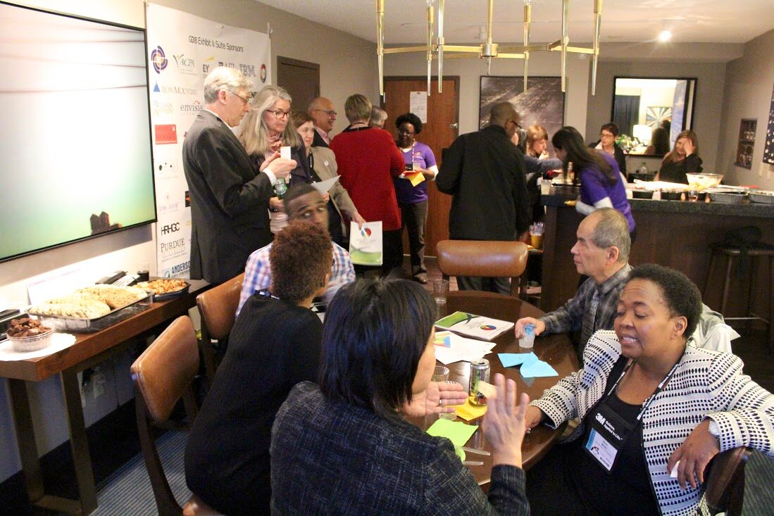

Slide 51
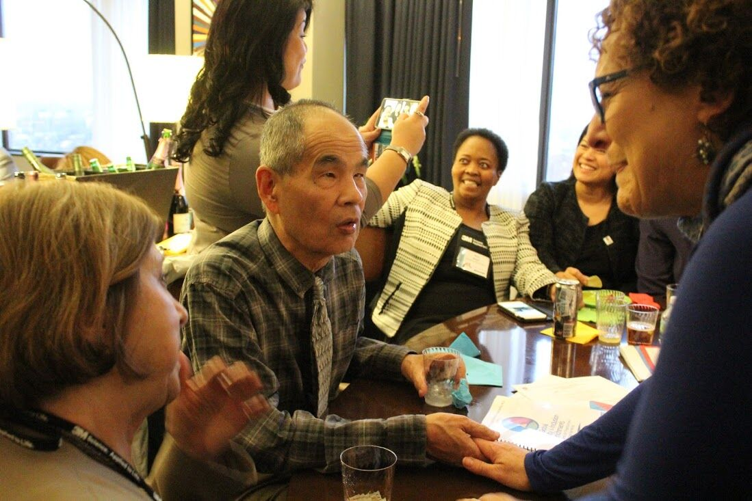

Slide 52
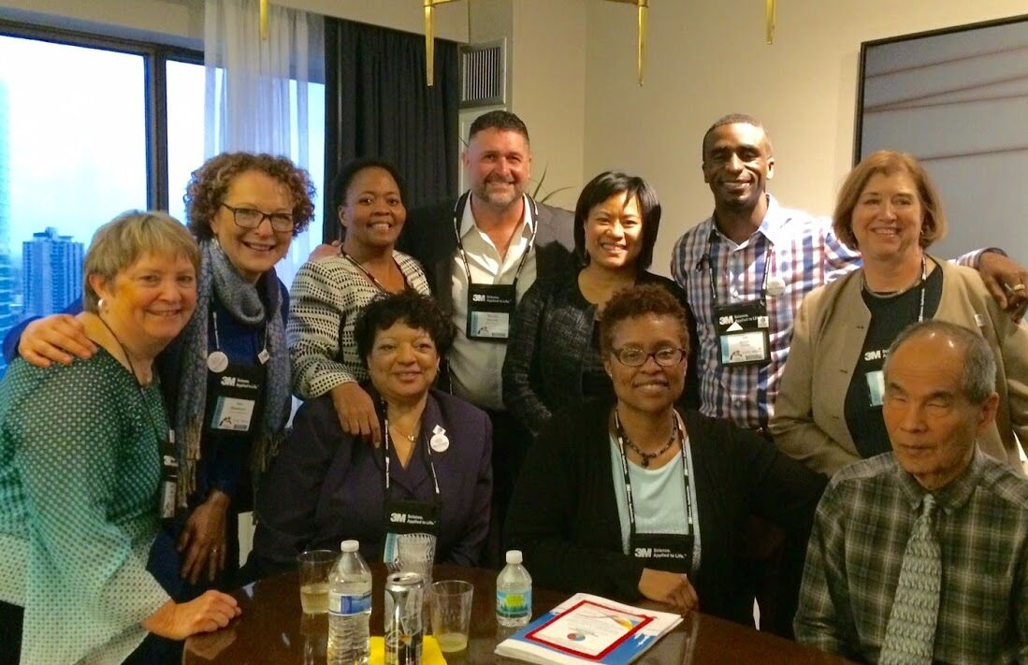

Slide 53
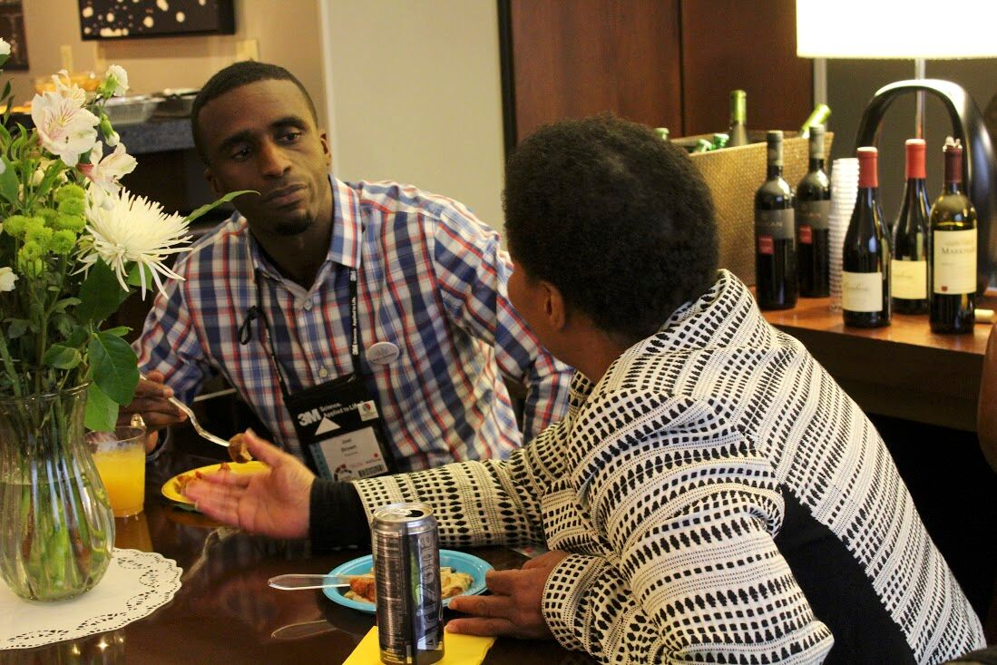

Slide 54
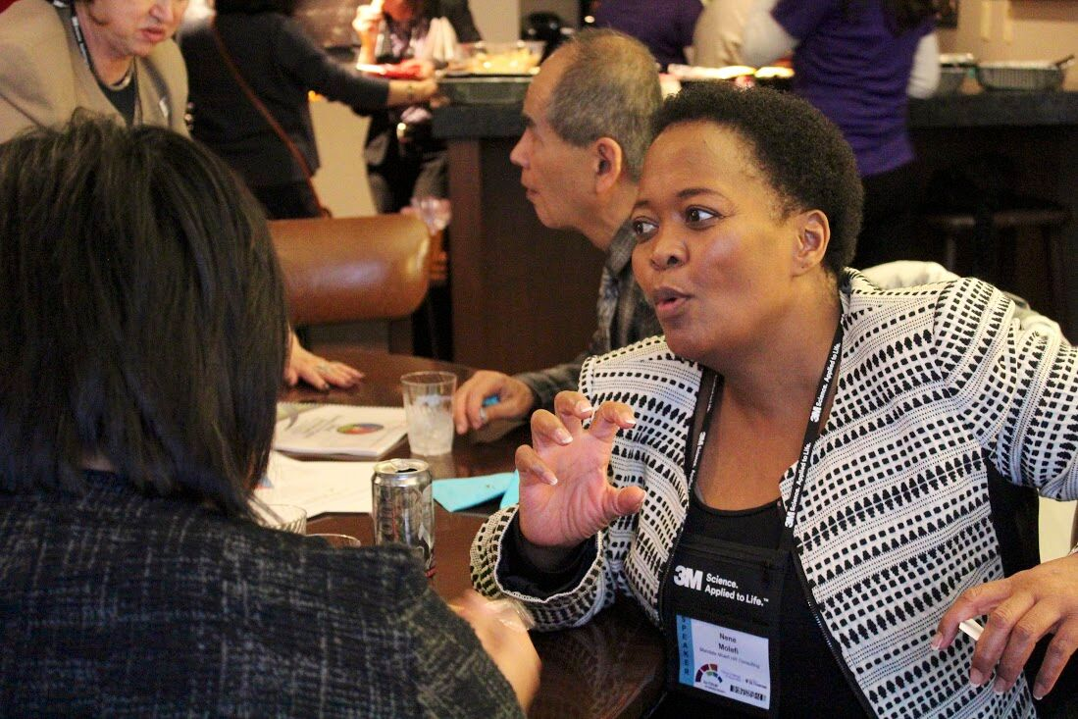

Slide 55
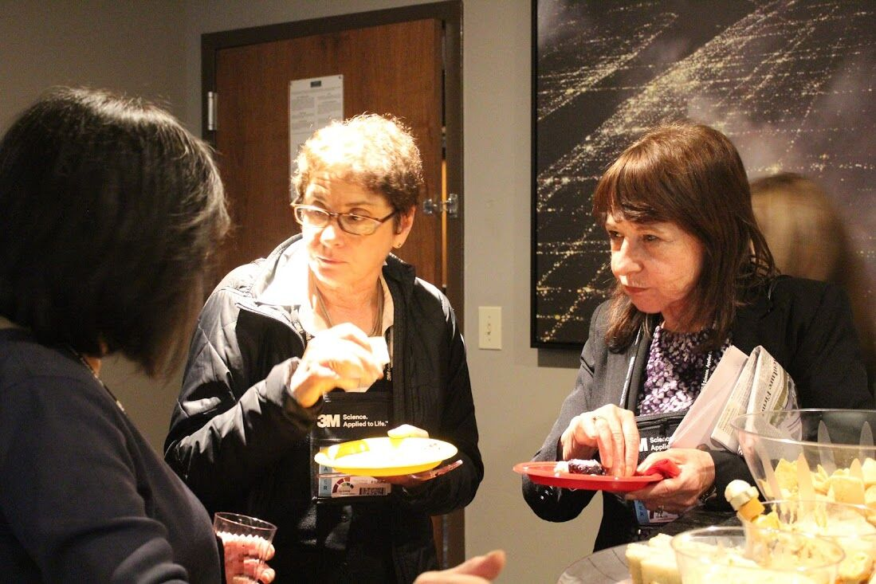

Slide 57
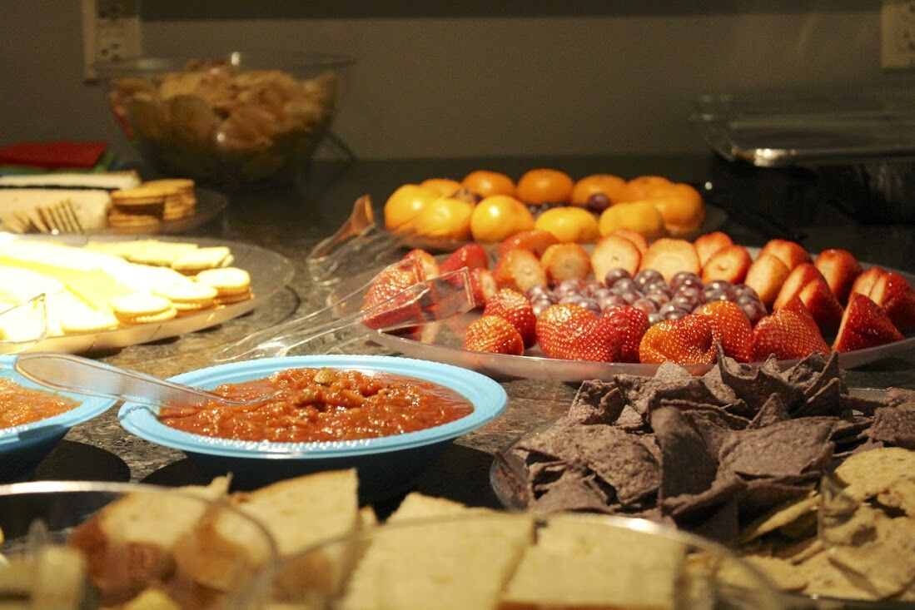

Slide 58
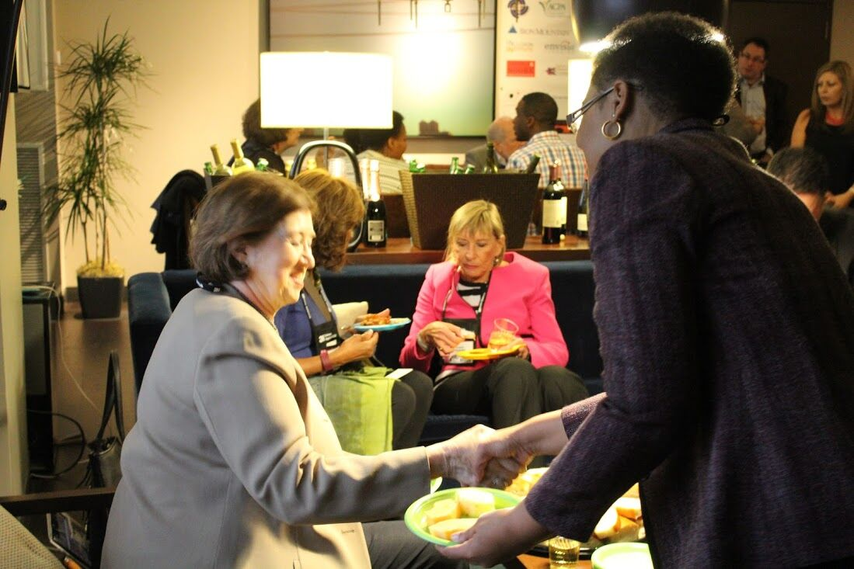

Slide 59
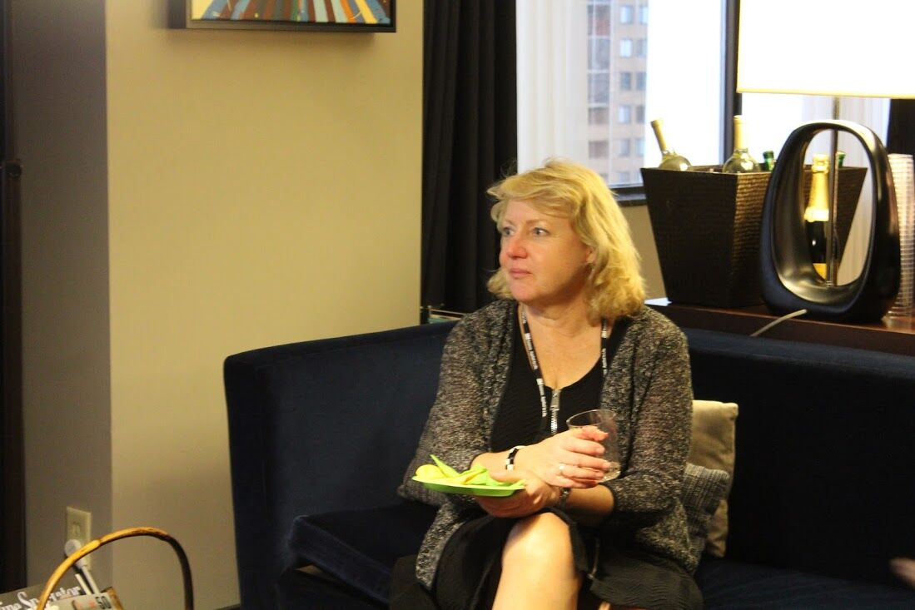

Slide 60
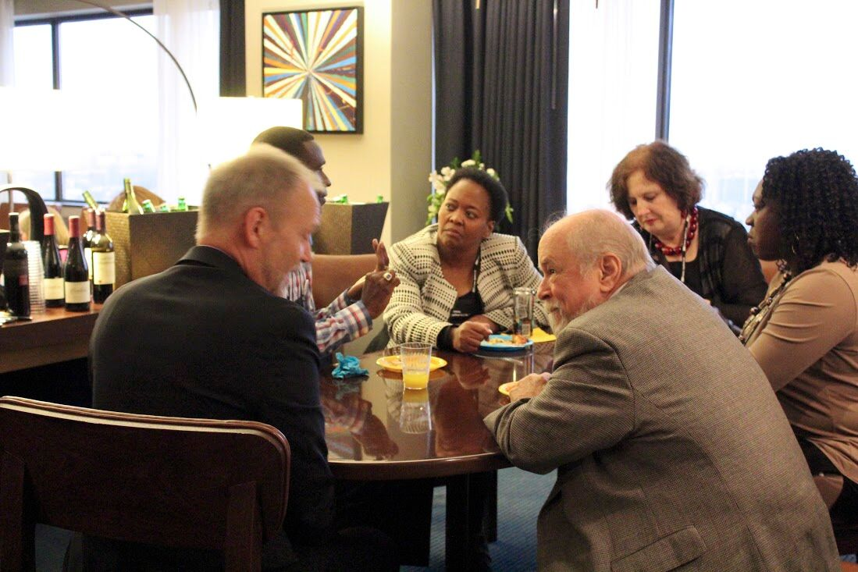

Slide 61
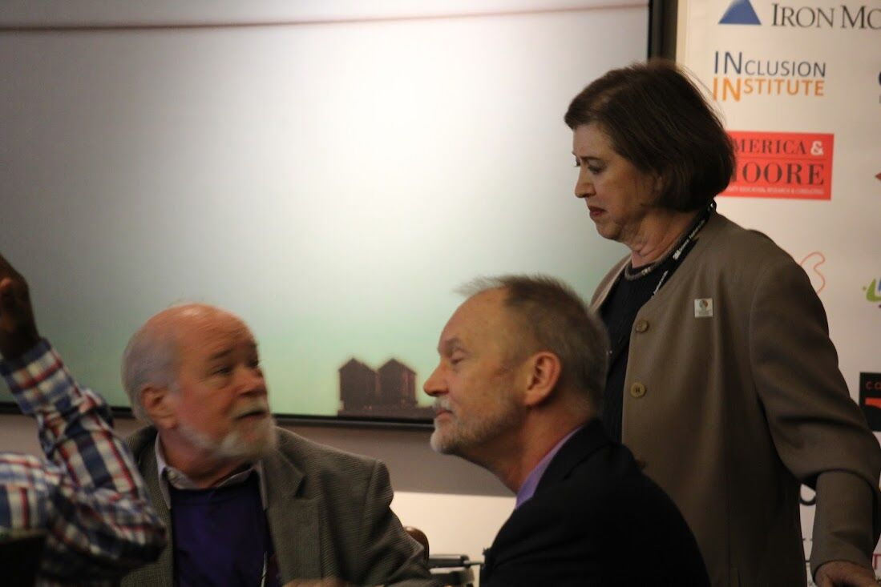

Slide 62
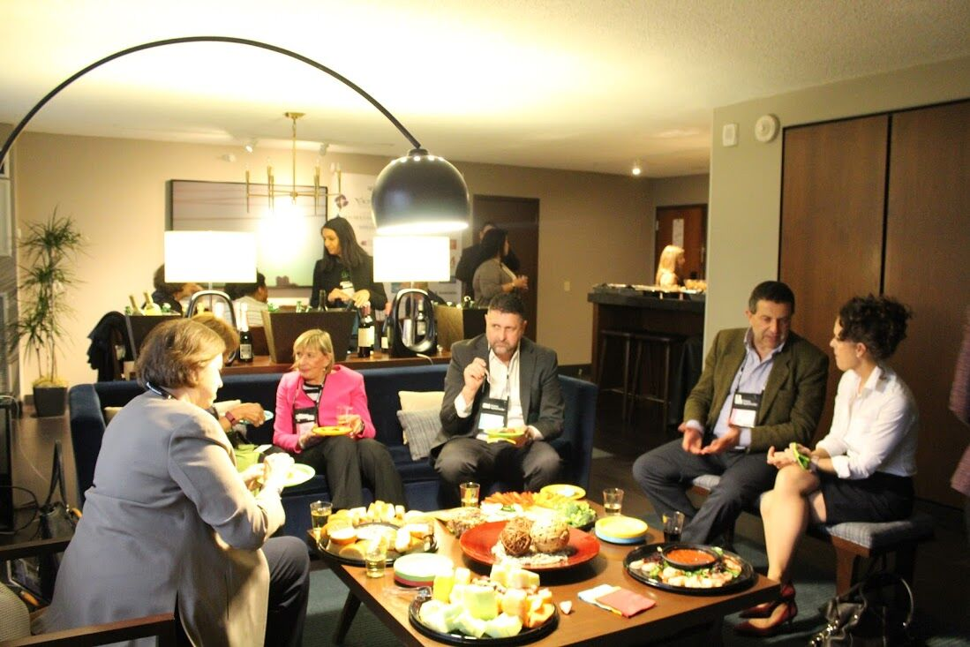

Slide 63
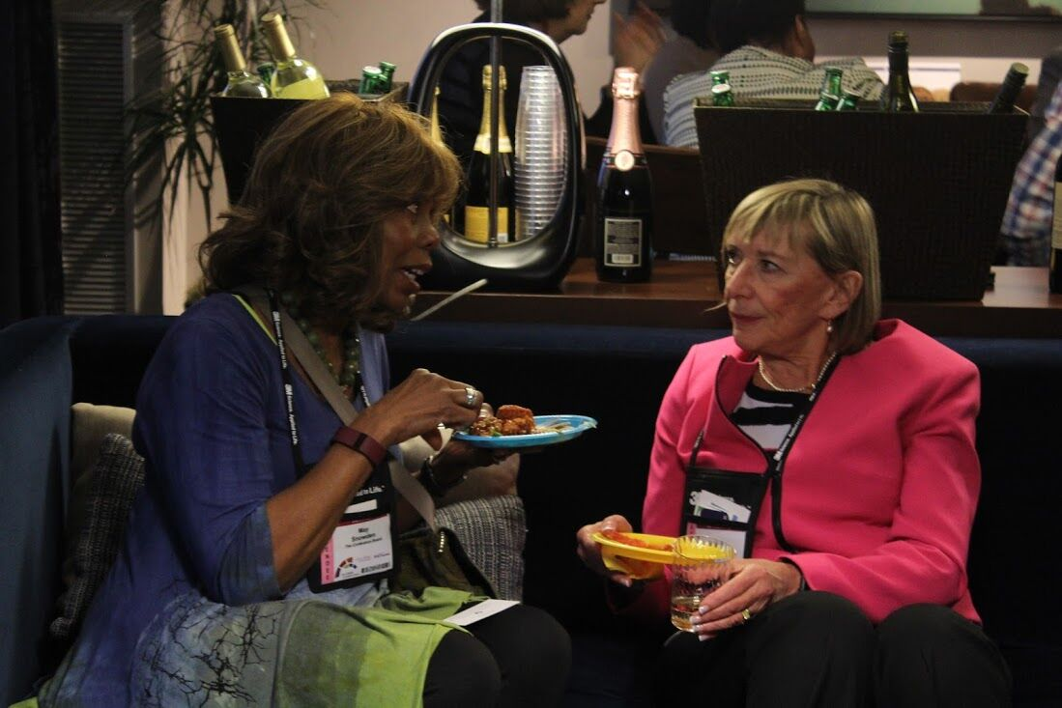

Slide 64
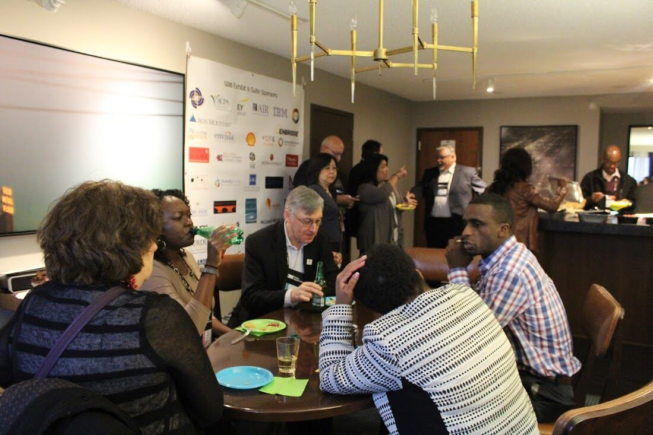

Slide 66
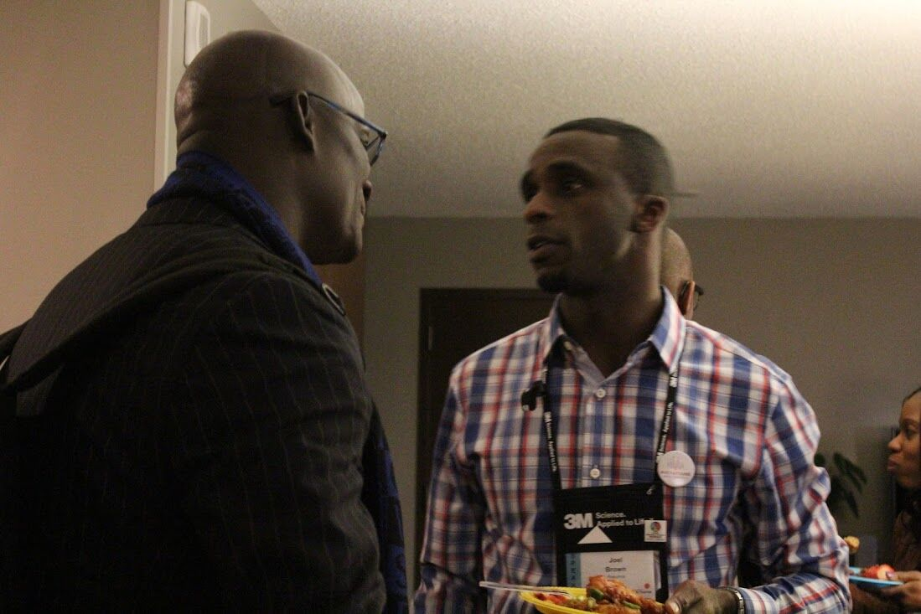

Slide 67
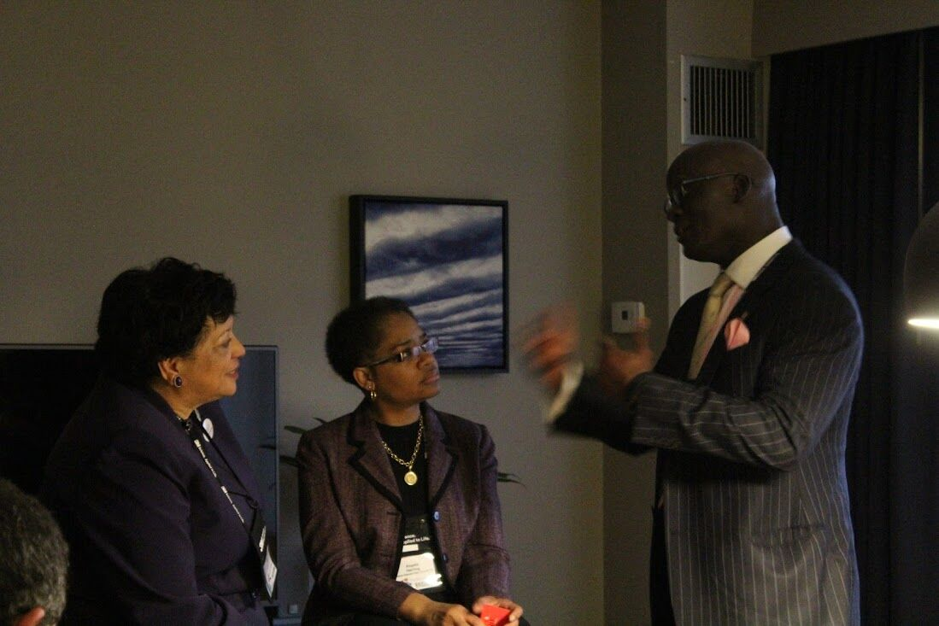

Slide 68
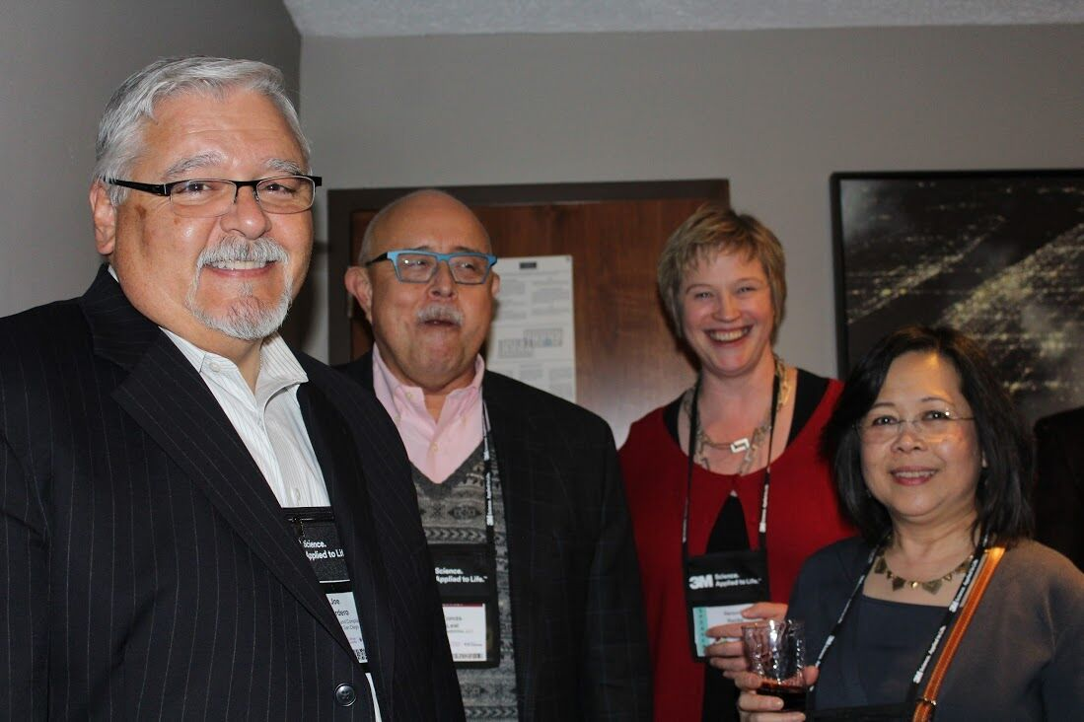

Slide 69
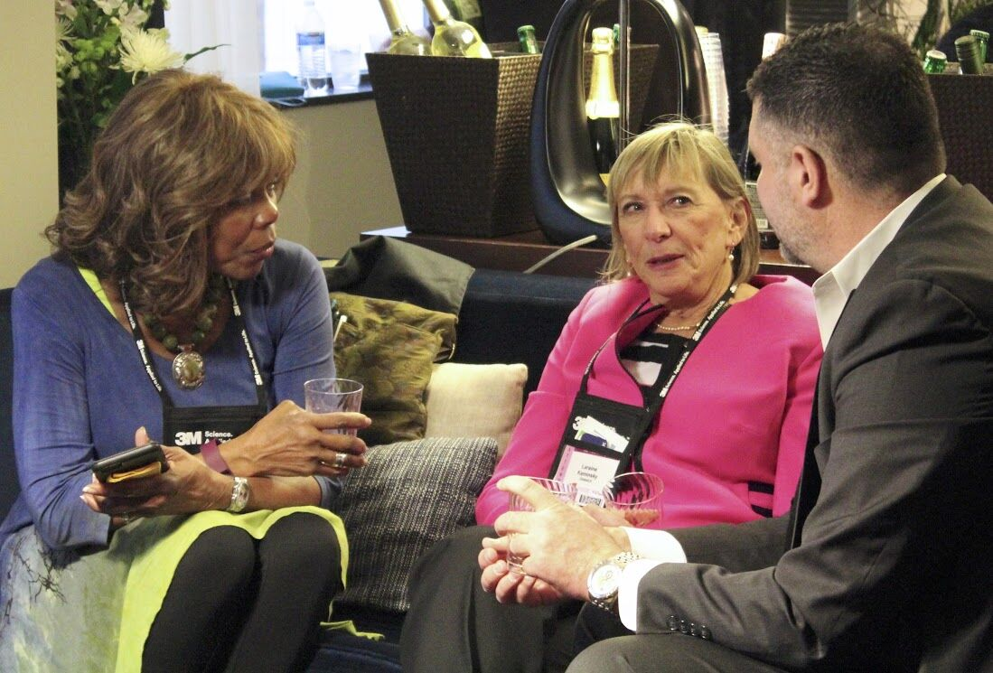

Slide 70
Collegium Emeritus Member
Mary-Frances Winters
Receives Winds of Change Award

Slide 72
