Slide 1

Miscellaneous GDIB Slides
For Expert Panelists & GDIB Users
Here is a collection of slides on the GDIB for your use in designing presentations.
It generally walks you through the GDIB as if you were reading it. There are a few exceptions to the order and content, but this slide deck is meant to be general. Select the ones you wish to use. Some slides are animated. It is unlikely you will use all the slides.
Some slides have notes to help explain the content of the slide.
You must have signed the GDIB Permission Agreement to use slides in this deck. Go to Permission Information on www.diversitycollegium.org (scroll from Global D&I Benchmarks) for a copy. As you will read in the Permission Agreement we are striving to keep the design quality and “look and feel” of the GDIB in all that we do. However, you are welcome to add your logo to this presentation and incorporate these slides in another deck. However we ask that you strive to maintain the look and feel. You are also welcome to translate the slides, although that will require special permission.
If you create additional slides / other versions, and are willing to share them, please send to GDIB@diversitycollegium.org
Please remember to show the copyright on all slides.

Slide 2
A Tutorial on
Global Diversity and Inclusion Benchmarks: Standards for Organizations Around the World
By Julie O’Mara, Alan Richter, and 95 Expert Panelists
Notes:
With this first slide on the screen, you may want to describe the goals and agenda of your presentation and your role / use of the GDIB. Also please mention that it is a free resource at least once during your presentation.

Slide 3
The GDIB Helps Organizations
Realize the depth, breadth, and integrated scope of D&I practices;
Assess the current state of D&I;
Determine strategy, and;
Measure progress in managing diversity and fostering inclusion.
Notes:
(copy from GDIB pages to use to speak to this slide)
We offer the Global Diversity & Inclusion Benchmarks: Standards for Organizations Around the World (GDIB) to support organizations globally in the development and implementation of Diversity and Inclusion (D&I) best practices.
The GDIB helps organizations:
Realize the depth, breadth, and integrated scope of D&I practices;
Assess the current state of D&I;
Determine strategy, and;
Measure progress in managing diversity and fostering inclusion.
Diversity and Inclusion has emerged as a worldwide practice that is critical to an organization’s success. As with other disciplines, such as quality and safety, standards are needed to establish criteria by which to measure and monitor progress.

Slide 4
We’ve learned what works
Notes:
Here is another way to say what GDIB is and does.
This phrase was the headline of the press release announcing the 2016 Tenth Anniversary Edition.

Slide 5
Helping to ensure that diversity and inclusion work is done at the highest quality level possible
Notes:
Here is another way to say what the GDIB is and does.
• The goal for publishing these Benchmarks is to encourage high-quality work in the D&I field, regardless of type of organization or where located.
• Sometimes people in organizations think that diversity and inclusion refers only to how well people get along and/or how much people know about customs and cultures and holidays.
• But high-quality diversity and inclusion can deliver organizational results:
that spark the development of innovative products and services and give the organization a competitive advantage,
that strengthen collaboration which results in smoother operations,
that literally saves lives in some healthcare instances where differences in beliefs can have negative consequences,
that inspire peace building in communities, and
that foster environments where people are retained and able to work at their full capacity.

Slide 6
If you want a quick fix,
GDIB is not for you.
Notes:
Some people complain that the GDIB is too long… that there are too many benchmarks. That we should advocate for organizations to “just pick a few things and do those well.”
Well… that’s not the GDIB. The GDIB is a systems approach –more on that later.
There are a lot of headlines and books that proclaim – diversity programs fail.
Well our view is that perhaps they fail because they aren’t comprehensive programs. They are ”diversity lite.”
If you want diversity lite, no need to continue with the GDIB.

Slide 7

The GDIB is Comprehensive
“The Diversity Collegium is particularly pleased to sponsor the GDIB because it explains what creating inclusive systems and managing diversity entails. We appreciate that the GDIB represents the best thinking of 95 experts around the world.”
“Extremely significant is that it is free
for anyone to use.”
Notes:
Our main sponsor is The Diversity Collegium. And much information about the GDIB is found on its website. You’ll see a slide at the end with the URL.
Having the support of the Diversity Collegium is significant because it is a group of seasoned professionals. Most Collegium active and emeritus members are Expert Panelists.

Slide 8
GDIB Sponsor:
The Diversity Collegium
Think Tank of practitioners, scholars, and leaders
Mission: To advance the field of D&I through dialogues, symposia, research, and publications.
Notes:
• The Diversity Collegium is a group of 25 professionals that has been meeting for more than two decades for the purpose of advancing the work that has come to be known as the field of Diversity and Inclusion.
• Its mission is to advance the field of D&I though dialogues, symposia, research, and publications.
• The Collegium members meet face-to-face twice a year to discuss current issues in the field. They conduct research and prepare papers on current and cutting edge questions.
• Membership in the group is by invitation only and is managed so that a balance of diversity is created among its members including such dimensions as race/ethnicity, industry, gender, and how one practices in the field.
• In late 2013 the membership voted to sponsor GDIB.

Slide 9

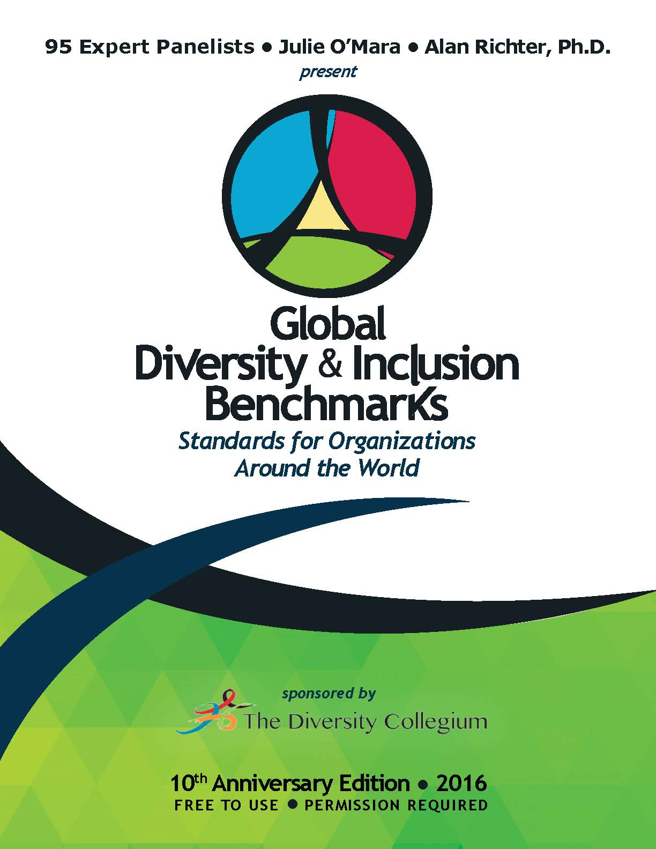


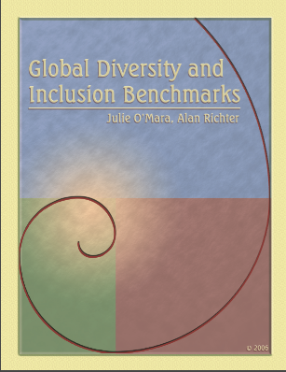

2016
Tenth Anniversary Edition
Co-Authors & 95 Expert Panelists
2014
GDIB
Co-Authors &
80 Expert Panelists
2011
GDIB
Co-Authors & 79 Expert Panelists
2006
GDIB
Co-Authors &
47 Expert Panelists
1993
Bench Marks for Diversity
Tennessee Valley Authority
GDIB EVOLUTION
Notes:
NOTE TO PRESENTERS – Go to The Research Process in the GDIB for more information. But here are a few points to say for this slide:
1990s Bench Marks for Diversity, published by the Tennessee Valley Authority (TVA), a government organization in the US. One of he original researchers is an EP.
2006: That document was updated and revised by the GDIB authors and sent to 47 Expert Panelists asking for comments and suggestions. The authors finalized the work, making judgments on what to accept and what not to accept, although most suggestions were accepted unless there was a conflict.
2011 the Expert Panelist group was expanded to 79. Numerous changes made to the benchmarks and introduction section expanded.
2014: The Diversity Collegium signed on as sponsor giving the GDIB nonprofit status and a new edition was created for that reason, but no substantive changes were made to the contents.
2016: 95 EP and substantial changes made including the addition of a category on sustainability, significant improvements in the benchmarks, added ultimate goals, work on language that crosses sectors, graphic revision of the model, explanation of systems impact, review for possible Western-centric emphasis, clarification of benchmarks levels, update to its accessibility for people with disabilities, numerous other factors, and an update of the appearance and graphics.

Slide 10

The GDIB is Accessible for People with Disabilities
World Wide Web Consortium
an international community that develops Web standards
Notes:
(copy from the inside front cover of the GDIB)
The GDIB authors are striving to make the GDIB and user tools accessible. Generally we are following the guidelines provided by the W3C Web Accessibility Initiative (WAI), a worldwide initiative to make the Web more accessible for persons with disabilities, which is a critically important D&I goal.
As this 2016 GDIB goes to press, and while we have designed this edition of GDIB with accessibility in mind, we still have some work to do. For that reason and for further accommodation we are also providing an Alternate Format version.
The Alternate Format version is a Microsoft Word version that may be obtained by emailing GDIB@diversitycollegium.org

Slide 11

Symbolism of the GDIB Logo
Notes:
The logo is a stylized version of the new GDIB Model.
It is set in a circle to convey the ongoing and never-ending importance of diversity and inclusion.
The equilateral triangle in the center symbolizes equality and solidarity or strength and represents the Bridging Group.
Colors have a wide range of meaning across cultures. What may be interpreted as a positive meaning for one color in one culture may be a nearly opposite meaning in another culture. We have been thoughtful in our selection of colors and offer our interpretation, which is a combination of a various cultural symbolism. The color yellow was selected for Bridging because it stands for optimism and imagination. The green color for the Foundation Group symbolizes nature and renewal, blue for the Internal Group represents harmony and order, and red for the External Group stands for passion and strength. All are in a vibrant hue, which symbolizes the vitality to succeed.
The swirls of dark blue represent the power, energy, and motion needed to sustain this work.
And the openness of the swirls showing the colors overlapping one another symbolizes the integration and comprehensiveness needed for D&I to succeed.

Slide 12

The GDIB uses
Intercultural English
Culturally neutral English principles
Clear, translatable language
Avoid culturally specific words and phrases,
such as idioms or local expressions
American English spelling is used
Notes:
NOTE TO PRESENTER: Just review the bullets on the slide. If you like you may pull an example relevant to your audience.

Slide 13
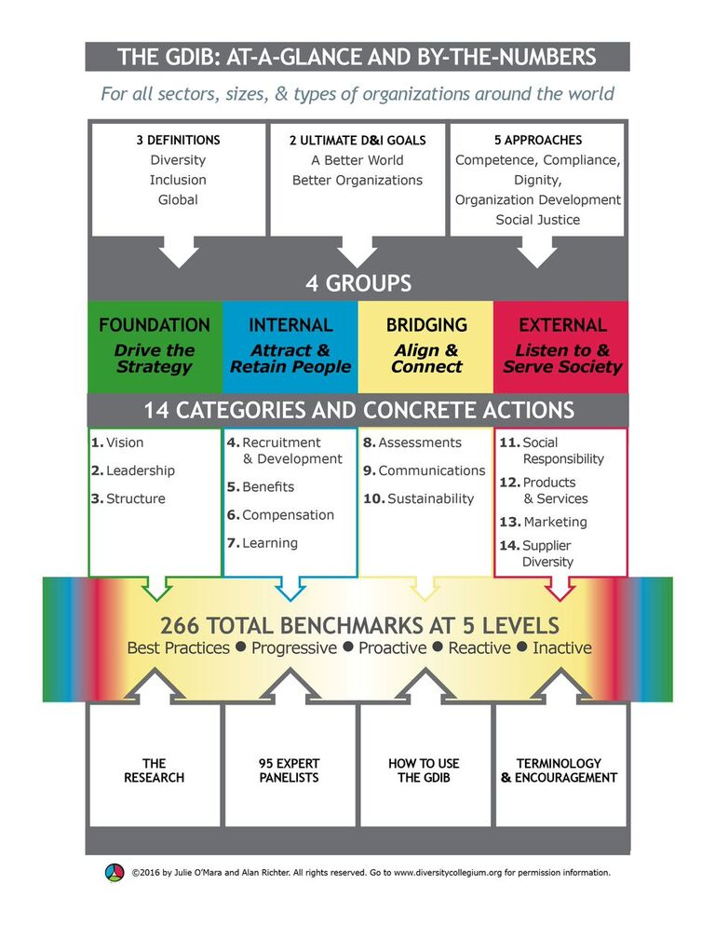
Notes:
This is a graphic table of contents—a static infographic. We have plans to animate this and put it on YouTube.
The key elements contained in the 80-page GDIB … a PDF are:
3 definitions
2 ultimate goals
5 approaches
4 groups of Categories
14 categories
266 Benchmarks at 5 levles
And then information on the
-- research
-- the 95 expert panelists
-- how to use the GDIB
-- and terminology followed by
The authors and 95 Expert Panelists.

Slide 14
Diversity Definition
The variety of differences and similarities/ dimensions among people, such as:
  Age
  Belief system
  Class/caste
  Culture
  Disability
  Education
  Ethnicity
  Gender
  Gender identity
  Generation
  Geography
  Job role and function
  Language
  Marital status
  Mental health
  Nationality
  Native or indigenous origins
  Parental status
  Personality type
  Race
  Religion
  Sexual orientation
  Thinking style
  Work experience
  Work style
Notes:
There are three important definitions to know to fully understand Global Diversity and Inclusion Benchmarks: diversity, inclusion, and global.
• All three of these definitions were agreed to by the Expert Panelists (more on them later). You will find – literally – thousands of definitions of diversity and inclusion as well on the Internet. However, this definition has been agreed to by the Expert Panelists, so it is a pretty solid definition worth using.
• Diversity is the wide variety of differences and similarities – referred to as dimensions – among people.
• Listed here are some of the key dimensions.
We are sensitive that what the the various diversity dimensions ae named may vary by geography, sector, or organization.
And in some parts of the world homosexuality is illegal and/or considered immoral. Nevertheless, it is a dimension of diversity.

Slide 15
Inclusion Definition
A dynamic state of operating in which diversity is leveraged to create a
fair,
healthy, and
high performing organization or community.
An inclusive environment ensures equitable access to resources and opportunities for all.
It also enables individuals and groups to feel safe, respected, engaged, motivated, and valued for who they are and for their contributions toward organizational societal goals.
Notes:
The term inclusion has been described by practitioners and scholars in several different ways.
In Global D&I Benchmarks the important quality of inclusion is that it helps create a fair, equitable, healthy, and high-performing organization or community.
And in that organization or community, people are valued.
These are the end-goals.
The above slide is the exact wording of the definition as it appears in the GDIB.

Slide 16
Global Definition and Scope
These Benchmarks apply to all organizations around the world.
They are not limited to multinational organizations that work internationally.
They are not specific to a country, culture, D&I approach, sector, industry, or size of organization.
Notes:
• For Global D&I Benchmarks, the definition of global simply means that these Benchmarks can be used around the world by all organizations and communities.
• These benchmarks are not just for organizations that have customers or locations around the world. They apply to all organizations no matter where they are located.
NOTE TO PRESENTERS: This definition of global is very confusing to some. In fact, some organizations don’t use the GDIB because they say “we are not global.” Some will say something like “We aren’t located or don’t sell our products around the world, but we have people employed here that were not born here.” But, that is not even the point – all the benchmarks are written to apply to organizations – even the corner grocery store (although a lot of modification may be needed). It just mans that the standards are designed to work “all around the world – whether the organization has locations or employees or markets around the world or not.
It is very important to get this point across.

Slide 17

Ultimate Goals of Diversity & Inclusion
Create a Better World
Improve Organizational Performance
Notes:
Copy from the GDIB:
When considering the ultimate goals of Diversity and Inclusion (D&I), people tend to emphasize one of two perspectives: helping to make the world a better place for all or helping to improve organizational performance. The priority of one perspective over another may be influenced by circumstance or context. Some people emphasize that not only are these perspectives complementary but that when D&I work is done well both goals are achieved.
The next several slides are descriptions of each perspective and the related role of the GDIB.

Slide 18
Creating A Better World
Contribute to the greater good of society
Create a world which is fair and just and respectful of individuals and their similarities and differences
Create a world where everyone is able to sustain a high quality of life and enjoy peace and prosperity
Globally, social justice underpins much of the D&I work being done in public policy and development initiatives. As well, there are many organizations firmly committed to doing what is right and ethical for all stakeholders.
Notes:
Copy from the GDIB:
Professionals in the field, people engaged in D&I, and colleagues at progressive organizations agree that the ultimate goal is to help create a world that is better for everyone. The goal may be stated in different words and with different points of emphasis; however, a consensus exists on a long-term purpose:

Slide 19
Improving Organizational Performance
A more immediate (and some would suggest more direct) outcome of D&I is to help improve organizational performance. This is commonly referred to as the business case or rationale. Each organization should develop its own business case or rationale for D&I.

Slide 20
Improving Organizational Performance
A well-designed and well-executed D&I strategy can help an organization:
Achieve its organizational vision, mission, strategy and annual goals/objectives
Attract and retain diverse talent
Build strong and high-performing teams
Cultivate leaders who inspire inclusion and champion diversity
Notes:
No additional copy.

Slide 21
Improving Organizational Performance
(continued)
Leverage an extensive range of backgrounds and skills to enhance creativity, innovation and problem solving
Increase engagement, motivation, and productivity
Improve the quality of work/life integration
Enhance the organization’s reputation/brand as an employer or provider of choice
Minimize risk/exposure and ensure compliance with legal requirements
Sustain an environment that treats people fairly
Notes:
No additional copy.

Slide 22

Competence
Improving Skill, Knowledge, and Ability
Social Justice
Treating People Equitably and Ethically
Compliance
Complying with Laws and Regulations
Dignity
Affirming the Value and Interconnectedness of Every Person
Organization Development
Improving Organizational Performance
Approaches to Diversity & Inclusion
Notes:
Numerous approaches to D&I. We’ve identified 5, not to say all must follow or agree to them…BUT to state that they exist. The GDIB provides more extensive descriptors and terminology often used within these 5 umbrella approaches.
Important to highlight 3 things:
There is much overlap among the 5 approaches
The approaches operate as a system (work and progress in one approach quite probably impacts another approach)
We NOTE: Descriptors may have different meanings in different cultures and language translations may alter the meaning of specific words.
NOTE TO PRESENTERS: See copy in the GDIB. 5 slides follow – each with more information on one approach.

Slide 23
COMPETENCE: IMPROVING SKILLS, KNOWLEDGE, AND ABILITY
Competence
Improving Skill, Knowledge, and Ability
This approach focuses on increasing the competence of individuals and organizations to interact effectively in the context of many similarities and differences. Measures of success align with demonstrated competence.
Terms sometimes used when describing this approach:
Awareness
Bias reduction
(conscious and unconscious)
Cultural competence
D&I skills training
Intercultural communications
Multicultural education

Slide 24
COMPLIANCE: COMPLYING WITH LAWS AND REGULATIONS
Compliance
Complying with Laws and Regulations
Most organizational and societal entities have laws, rules, codes, guidelines, norms, and the like that indicate how people within and sometimes outside of those entities are expected and/or required to behave.
Terms sometimes used when describing this approach:
Affirmative action
Employment equity
Equal Opportunity
Human Rights
Regulatory
Representation/targets/quotas

Slide 25
DIGNITY: AFFIRMING THE VALUE
AND INTERCONNECTEDNESS OF EVERY PERSON
Dignity
Affirming the Value and Interconnectedness of Every Person
This section includes secular and religious perspectives that recognize the value and worth of every human being and our interdependence.
Terms sometimes used when describing this approach:
Cultural humility
Mindfulness
Right thing to do
Spirituality
Unity
Values

Slide 26
ORGANIZATIONAL DEVELOPMENT: IMPROVING ORGANIZATIONAL PERFORMANCE
Organizational Development
Improving Organizational Performance
This approach is distinguished by the weighting of performance goals in determining which actions to take to optimize personal and organizational performance.
Terms sometimes used when describing this approach:
Business imperative
Change management
Culture change
Leveraging diversity/differences
Systems change
Transformation

Slide 27
SOCIAL JUSTICE: TREATING PEOPLE EQUITABLY AND ETHICALLY
Social Justice
Treating People Equitability and Ethically
This approach is aimed at achieving justice and fairness, ultimately for everyone.
Terms sometimes used when describing this approach:
Equity
Human rights
Overcoming/dismantling oppression
Restorative justice
Social justice
Social responsibility

Slide 28

Effective D&I work is achievable when
it is strategic,
tied to the mission and goals of the organization,
led with competence and care, and
implemented in a sustainable manner.
Lynda White
Past-President of The Diversity Collegium
Notes:
This quote appeared in the press release to announce the 2016 GDIB. May 29, 2016.
At that time Lynda White was president. As of June 1, Michael Wheeler is president and Lynda is Past President.

Slide 29
We’re committed to creating a
diverse and inclusive environment
that drives ideas and innovation,
and will help us better meet the
financial needs of our customers.
Lorie Valle-Yañez,
Vice President and Chief Diversity Officer
Massachusetts Mutual Life Insurance Company
Springfield, Massachusetts
Notes:
This quote appeared in the press release to announce the 2016 GDIB. May 29, 2016

Slide 30
We customized the GDIB for cultural, localized meanings. When D&I was first introduced in Japan several years ago, it was seen as a western concept. In fact, there is not a Japanese character for the word ‘inclusion.’ The benchmarks accurately guided us when we broke ‘inclusion’ down into traits and other descriptive statements.
Janelle Sasaki
Executive Director of Diversity & Inclusion Services
Ernst & Young Advisory Co., Ltd.
Tokyo, Japan
Notes:
This quote appeared in the press release to announce the 2016 GDIB. May 29, 2016

Slide 31
The practical steps and incremental nature of the GDIB provides a clear sense of where you are and where you want to be.
Nene Molefi
Managing Director
Mandate Molefi
Johannesburg, South Africa
Notes:
This quote appeared in the press release to announce the 2016 GDIB. May 29, 2016

Slide 32
The GDIB spells out what good, better, and best work is. It readily frames where an organization
can focus its capabilities.
Ralph de Chabert
Senior Vice-President
Global Chief Diversity Officer
Brown-Forman Corporation
Louisville, Kentucky
Notes:
This quote appeared in the press release to announce the 2016 GDIB. May 29, 2016

Slide 33
The GDIB is a great tool to telescope from the macro to micro context when there are specific concerns
or issues that must be reconciled.
Cindi Love
Executive Director
American College Personnel Association
Washington, DC
Notes:
This quote appeared in the press release to announce the 2016 GDIB. May 29, 2016

Slide 34
The GDIB was created through a systematic and rigorous consensus of D&I experts. It was a year-long research process where the viewpoints of a significantly diverse group of experts — many of whom approached D&I work in very different ways — came to agreement on the outcomes that are needed. Modeling both diversity and inclusion throughout this process reminded us that while this work can be challenging, it is also hugely rewarding.
Duncan Smith
Founder and Principal
ADC Associates
Melbourne, Australia
Notes:
This quote appeared in the press release to announce the 2016 GDIB. May 29, 2016

Slide 35
A benchmark is:
An organizational standard of performance,
usually stated as an end result or outcome.
Benchmarking helps people in organizations
achieve high-quality results or aspirations.
Notes:
• Synonyms for the word benchmark, as we use it in GDIB, include standard, milestone, yardstick, and criterion for success.
• Usually an organization sets annual goals designed to move steadily toward reaching higher benchmarks. It may take several years and many activities to achieve the highest level benchmarks.
• Once a benchmark is reached, the organization must be committed to maintaining that standard in the years to come – or it may set even higher standards.
• Benchmarks at the highest levels are called best practices. In GDIB they are those at Level 5.
• Because organizations are different types and sizes and in different sectors and sometimes locations, the specific benchmarks will vary for each organization. Therefore the Global Diversity and Inclusion Benchmarks may need to be adjusted given your specific organization.
• We should mention competencies in this discussion. They are not the same as benchmarks. Competencies are important markers to assure that quality work is done. Competencies are the skills, knowledge, and ability that people need to achieve the benchmarks.

Slide 36
14 Categories in Four Groups
Foundation
Drive the Strategy
Bridging
Align & Connect
1: D&I Vision, Strategy, and Business Case
2: Leadership and Accountability
3: D&I Structure and Implementation
8: Assessment, Measure, and Research
9: D&I Communications
10: Connecting D&I and Sustainability
Internal
Attract & Retain People
External
Listen to & Serve Society
4: Recruitment, Retention, Development, and Advancement
5: Benefits, Work-Life Integration, and Flexibility
6: Job Design, Classification, and Compensation
7: D&I Learning and Education
  11: Community, Government Relations, and Social Responsibility
  12: Products and Services Development
  13: Marketing and Customer Service
  14: Supplier Diversity
Notes:
• Foundation Benchmarks are those used initially and throughout to build and sustain a D&I initiative.
• Internal Benchmarks focus on systems and processes that strengthen how the organization operates and how the effectiveness of people is increased.
• Bridging Benchmarks are critical linkages that bridge foundational work with the internal and external focus of D&I in the organization.
• External Benchmarks relate to how the organization offers its products and services and interacts with its customers and other stakeholders.
Let me give you two examples of what we mean by D&I working as a comprehensive system.
Example 1 of operating as a system: For recruitment (Internal) to be successful, the organization must have excellent relationships with the community (External), and communications efforts (bridging) both inside and outside the organization need to strong.
Example 2 of operating as a system: Customer Service (External) will be enhanced with excellent D&I education and training (Internal) that is reinforced when leaders are held accountable (Foundation) for the relevance and effectiveness of the training.
For most organizations work will need to be done in all categories simultaneously as activities must reinforce each other. The groups and categories are not sequential – you don’t start with one, then go to two and three and so forth. The benchmarks in various categories interact to support or reinforce each other.

Slide 37
GDIB Actions
DRIVE THE STRATEGY
Develop a strong rationale for D&I vision and strategy and align it to organizational goals.
Hold leaders accountable for implementing the organization’s D&I vision, setting goals, achieving results, and being role models.
Provide dedicated support and structure with authority and budget to effectively implement D&I.

Slide 38
GDIB Actions
ATTRACT & RETAIN PEOPLE
Ensure that D&I is integrated into recruitment, talent development, advancement, and retention.
Achieve work-life integration and flexibility.
Ensure that job design and classification are unbiased, and compensation is equitable.
Educate leaders and employees so they have a high level of D&I competence.

Slide 39
GDIB Actions
ALIGN & CONNECT
Ensure that assessment, measurement, and research guide D&I decisions.
Make communication a crucial force in achieving the organization’s D&I goals.
Connect the D&I and Sustainability initiatives to increase the effectiveness of both.

Slide 40
GDIB Actions
LISTEN TO & SERVE SOCIETY
Advocate for D&I progress within local communities and society at large.
Embed D&I in product and service development to serve diverse customers and clients.
Integrate D&I into marketing and customer service.
Promote and nurture a diverse supplier base and encourage suppliers to advocate for D&I.

Slide 41

The GDIB Model

Slide 42

BEST PRACTICE
    Demonstrating current best practices in D&I; exemplary for other organizations globally.
5
PROGRESSIVE
  Implementing D&I systemically; showing improved results and outcomes.
4
PROACTIVE
  A clear awareness of the value of D&I; starting to implement D&I systemically.
3
REACTIVE
  A compliance mindset; actions are only taken in compliance with relevant laws and social pressures.
2
INACTIVE
  No D&I work has begun; diversity and a culture of inclusion are not part of organizational goals.
1
FIVE LEVELS of PROGRESS

Slide 43

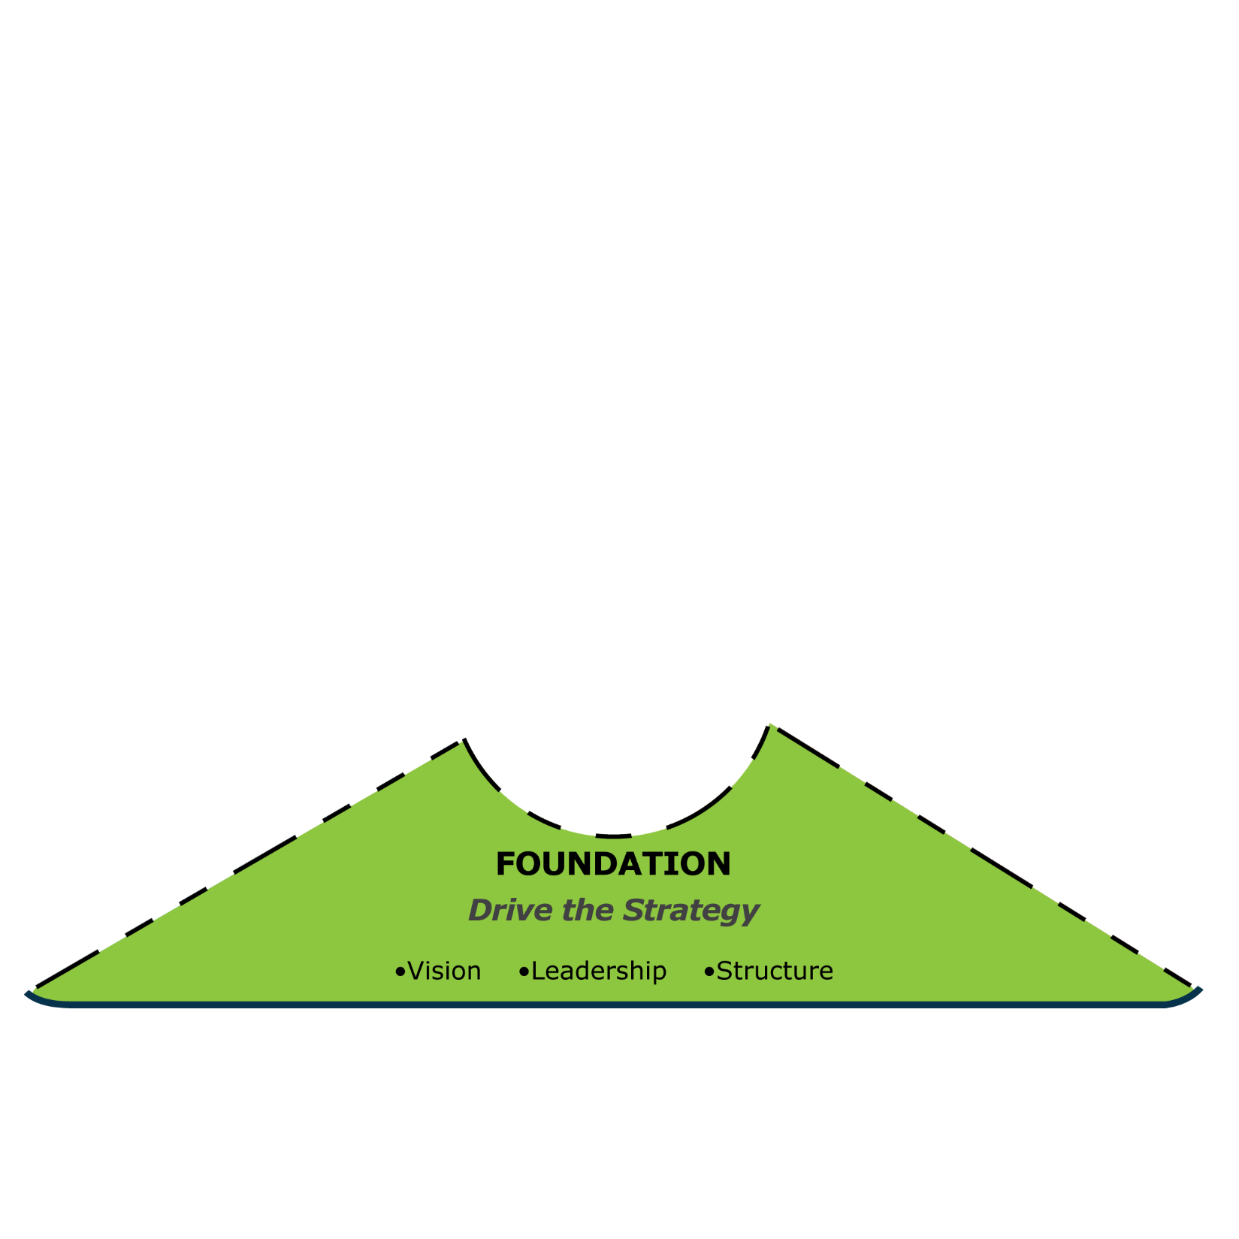
Drive the Strategy
Category 1
D&I Vision, Strategy, and Business Case
Develop a strong rationale for D&I vision and strategy and align it to organizational goals
Hold leaders accountable for implementing the organization’s D&I vision, setting goals, achieving results, and being role models
Category 2
Leadership and Accountability
Provide dedicated support and structure with authority and budget to effectively implement D&I
Category 3
D&I Structure and Implementation
FOUNDATION

Slide 44

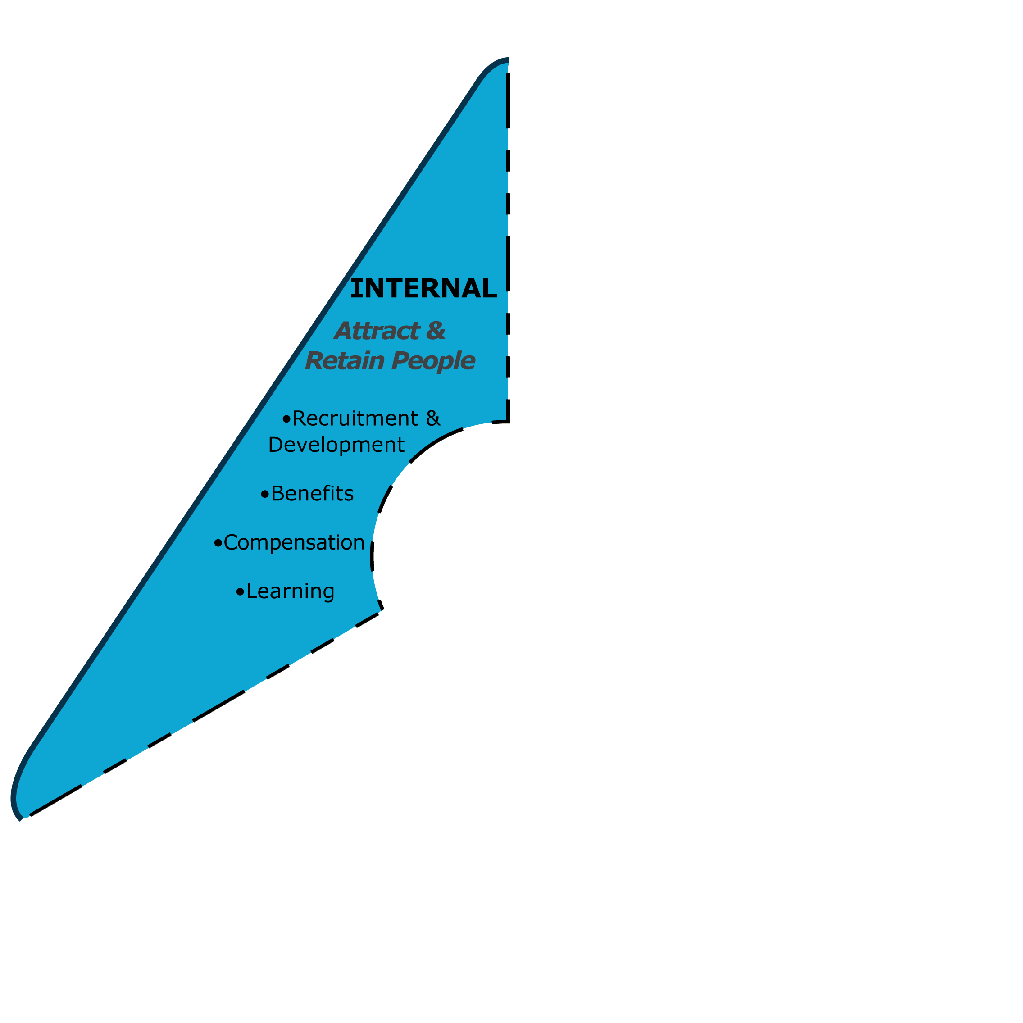
Attract & Retain People
Ensure that D&I is integrated into recruitment, talent development, advancement, and retention
Category 4
Recruitment, Retention, Development, and Advancement
Achieve work-life integration and flexibility
Category 5
Benefits, Work-Life Integration, and Flexibility
Ensure that job design and classification are unbiased, and compensation is equitable
Category 6
Job Design, Classification, and Compensation
Educate leaders and employees so they have a high level of D&I competence
Category 7
D&I Learning and Education
INTERNAL

Slide 45

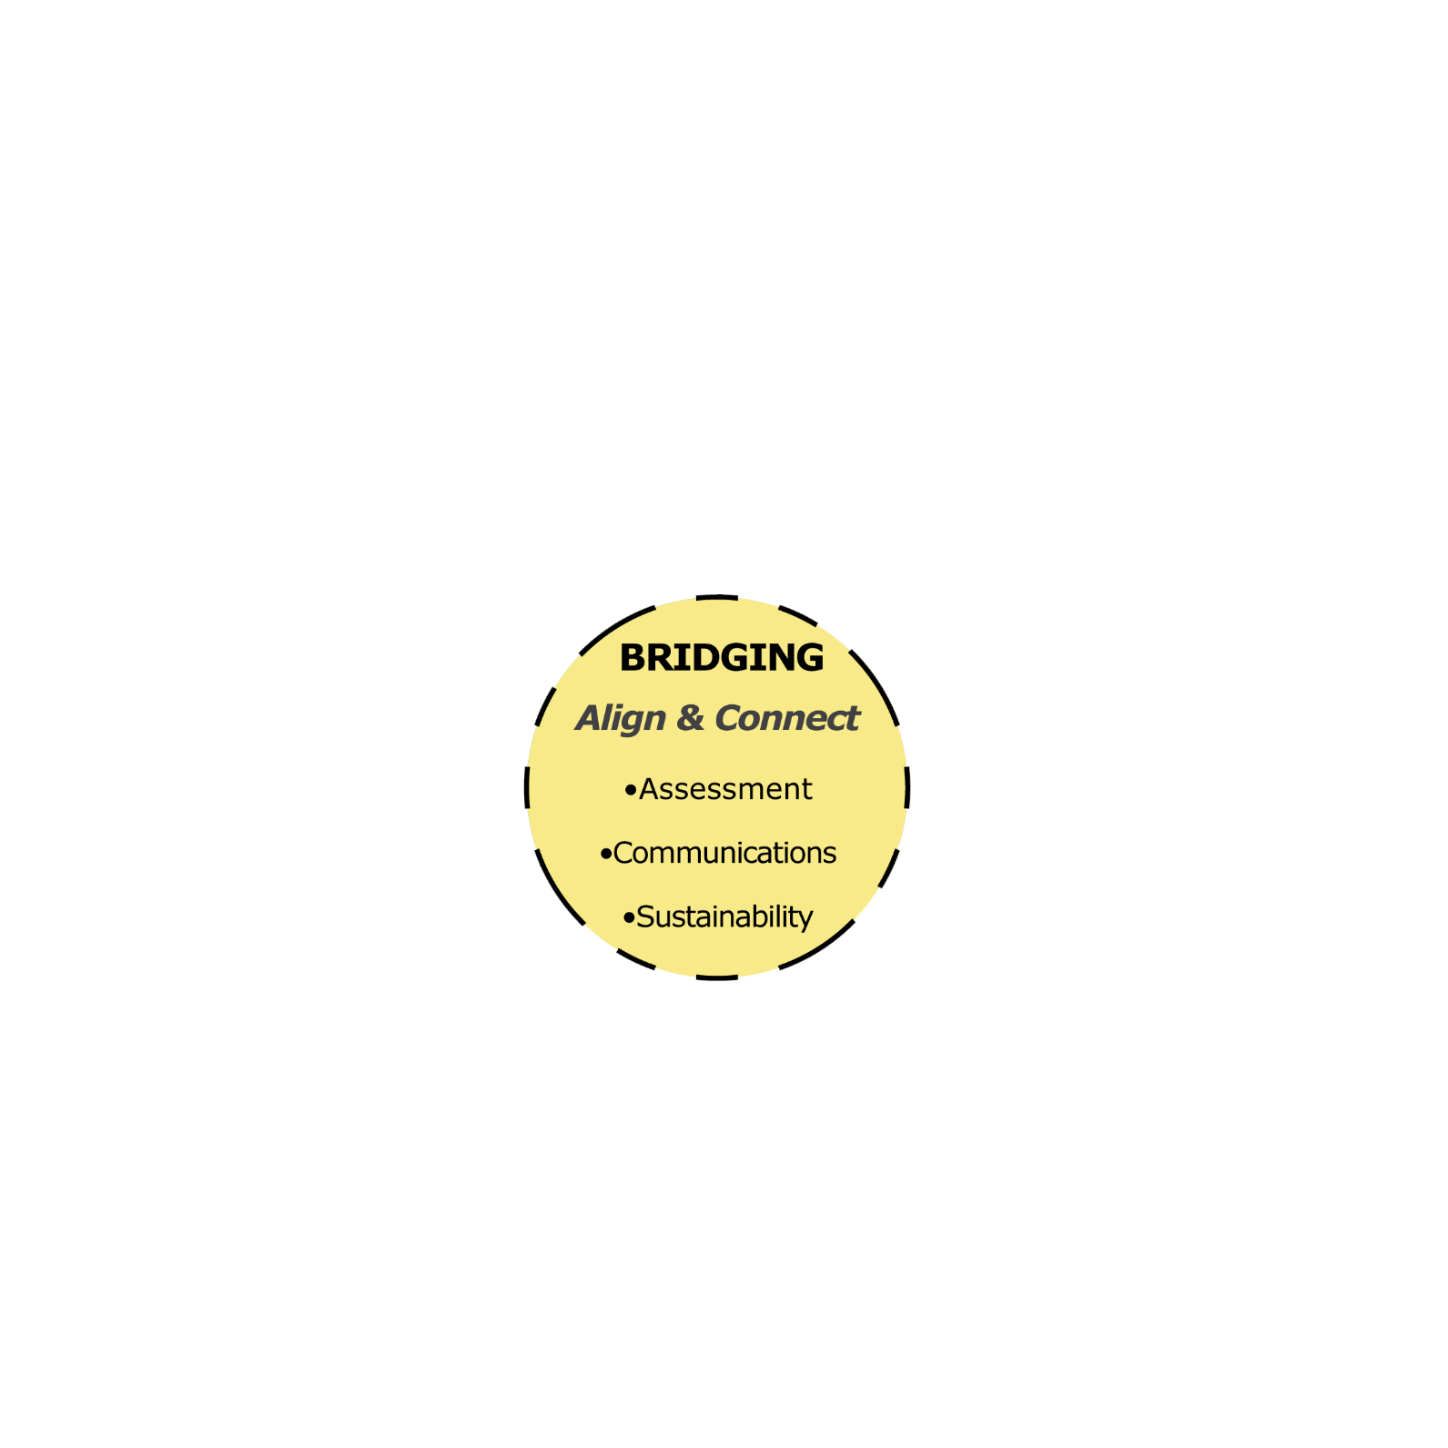
Align and Connect
Ensure that assessment, measurement, and research guide D&I decisions
Category 8
Assessment, Measurement, and Research
Make communication a crucial force in achieving the organization’s D&I goals.
Category 9
D&I Communications
Connect the D&I and Sustainability initiatives to increase the effectiveness of both
Category 10
Connecting D&I and Sustainability
BRIDGING

Slide 46

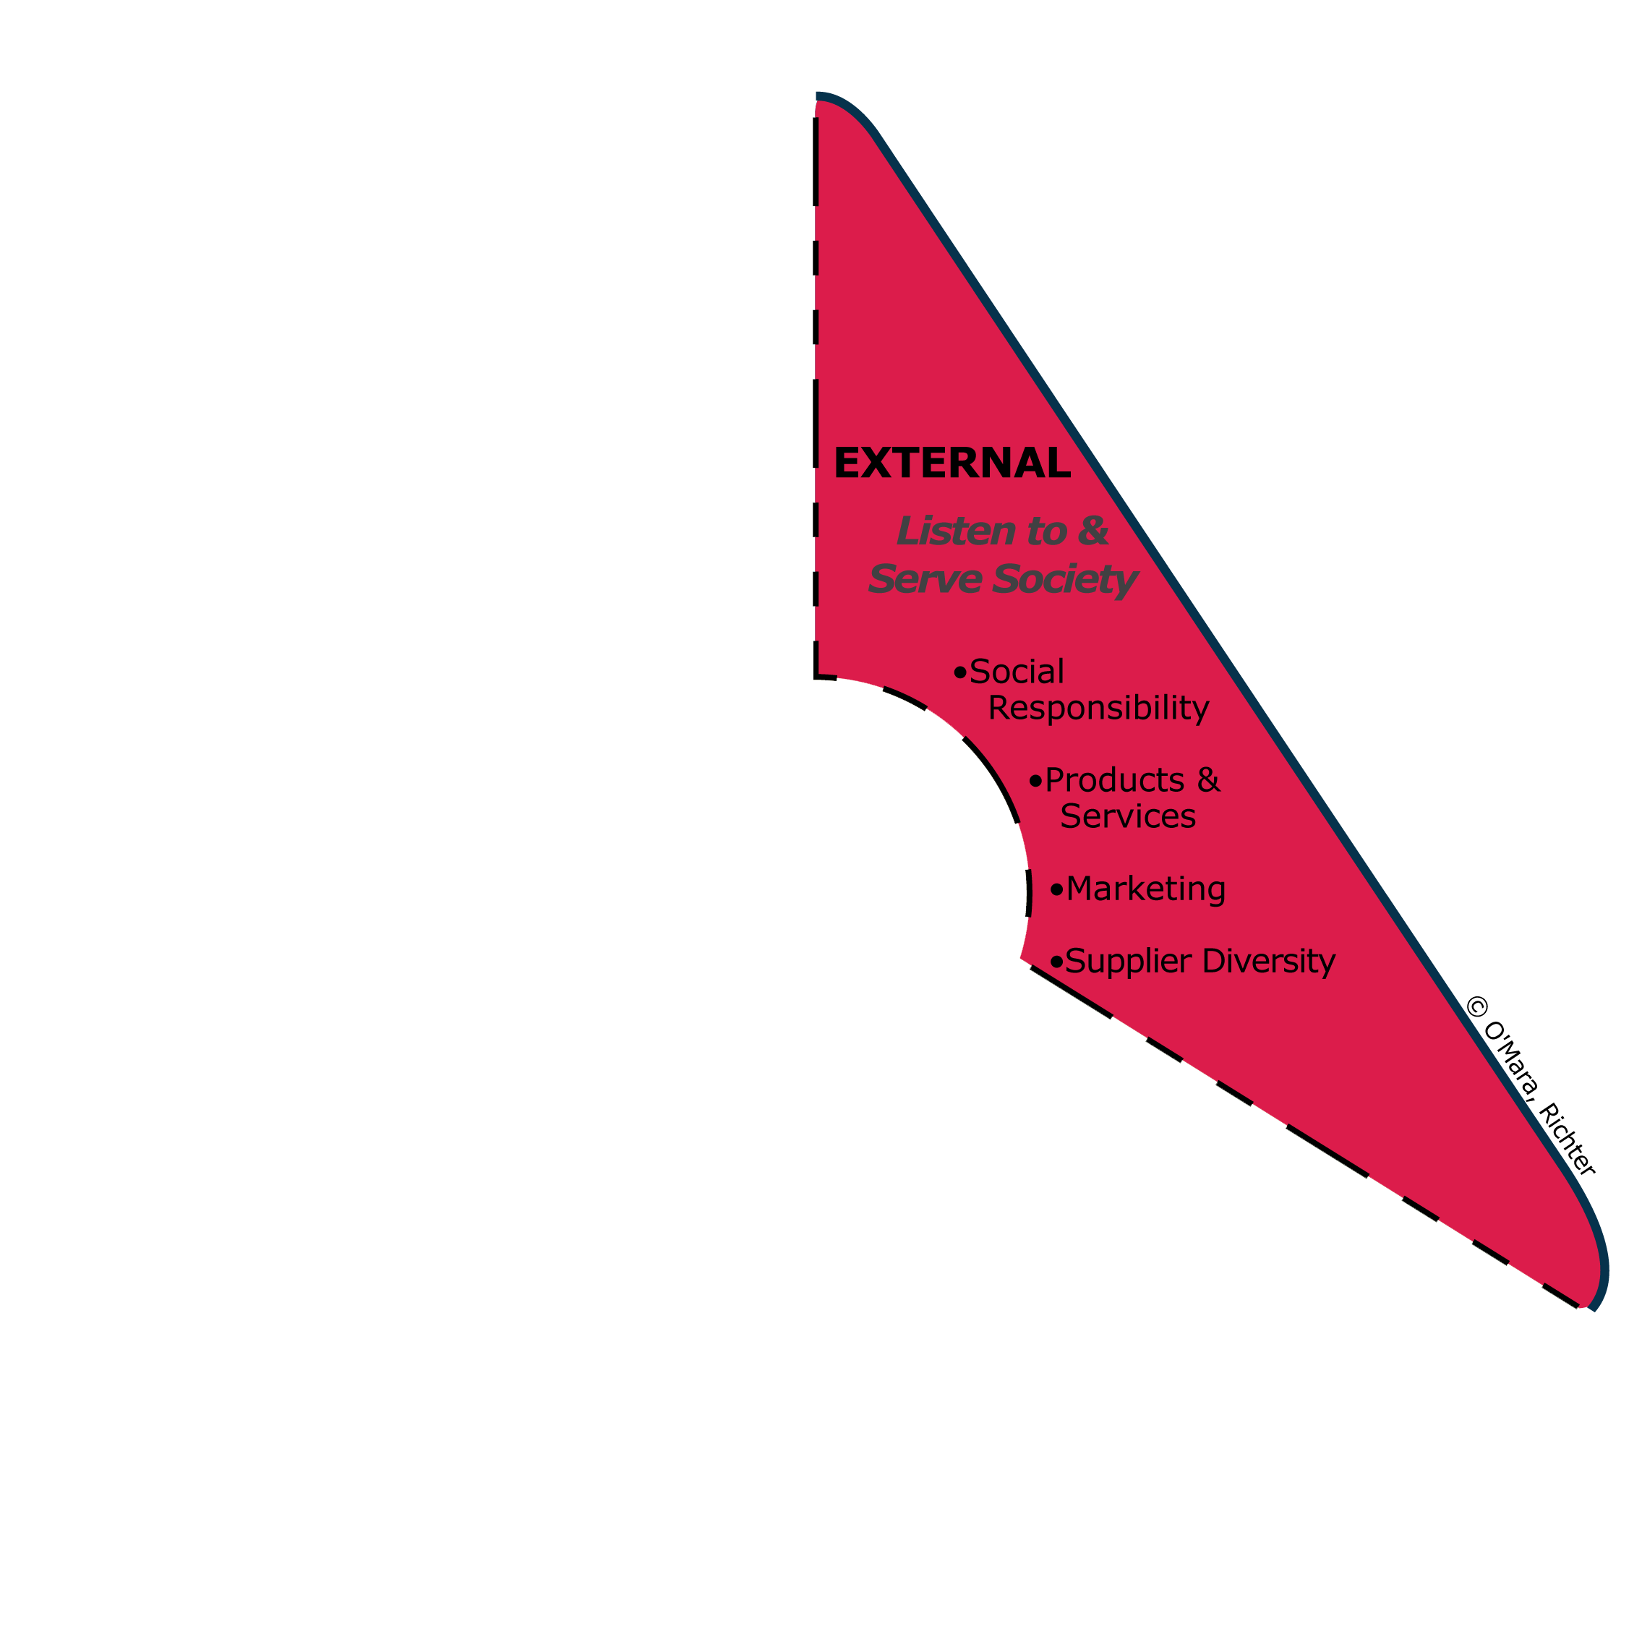
Listen to and Serve Society
Advocate for D&I progress within local communities and society at large
Category 11
Community, Government Relations, and Social Responsibility
Embed D&I in product and service development to serve diverse customers and clients
Category 12
Products and Services Development
Integrate D&I into marketing and customer service
Category 13
Marketing and Customer Service
Promote and nurture a diverse supplier base and encourage suppliers to advocate for D&I
Category 14
Supplier Diversity
EXTERNAL

Slide 47

New for 2016
Connecting D&I and Sustainability
Why the addition?
Growing trend of some
organizations connecting
D&I with organizational
sustainability processes
and outcomes
&
Transforming Our World:
The 2030 Agenda for
Sustainable Development
~Adopted by all 193 Governments of
the United Nations, September 2015
BRIDGING
Sustainability
Five (5) P’s
People
Planet
Prosperity
Peace
Partnership
Notes:
Broad definition and scope of sustainability
Why?
Impetus based on 2 main developments:
Organizations already connecting to sustainability and
Much like the GDIB is aligned with the 1948 United Nations Universal Declaration of Human Rights and other Human Rights Conventions and Declarations….we consider the 2030 Agenda for Sustainable Development as an aspiration for D&I
People —not only in the US — but globally are used to the 3 P's — people, planet, and profit…MOST people are focused on sustainability being about environmentalism only/primarily.

Slide 48
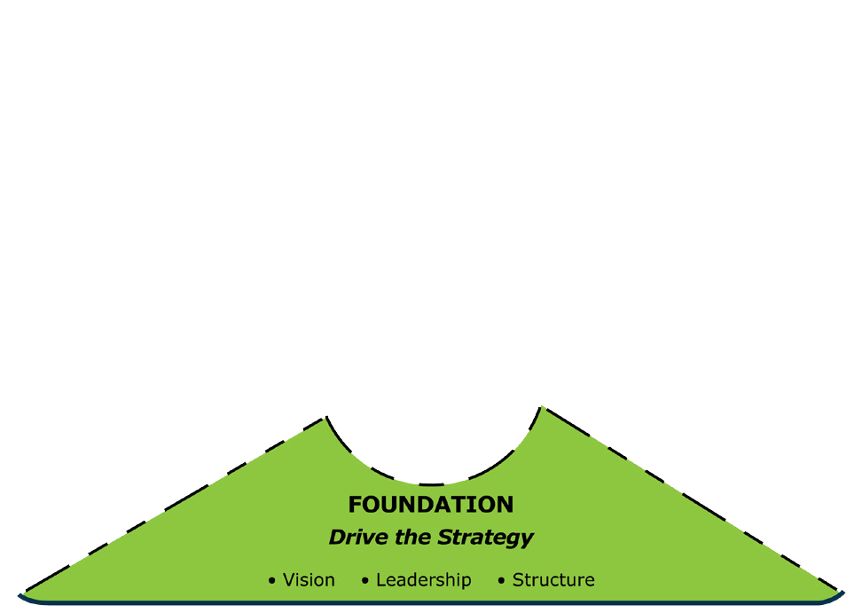
Sample Benchmarks at Level 5 Best Practice
Category 1: D&I Vision, Strategy, and Business Case
Action: Develop a Strong Rationale for D&I Vision and Strategy and Align it to Organizational Goals
☐ 1.1 D&I is embedded in organizational culture and is not seen as an isolated program but rather as a core value, a source of innovation, and a means to growth and success.
☐ 1.2 All the major components of D&I work, including vision, strategy, business case or rationale, goals, policies, principles, and competencies, are regularly reviewed.
Notes:
Summary of Category 1:
D&I is embedded in the values, culture, and processes of the organization and plays an integral part in achieving growth and success. There is a clear D&I vision and an explicit understanding of the rationale or business case, which allows for the development of measurements to track progress towards meeting D&I goals. There is clear evidence that accomplishing D&I goals leads to organizational success. The organization is a known leader in D&I and is frequently benchmarked by other organizations.

Slide 49
Sample Benchmarks at Level 5 Best Practice
Category 2: Leadership and Accountability
Action: Hold leaders accountable for implementing
the organization’s D&I vision, setting goals, achieving
results, and being role models.
☐ 2.3 Leaders are seen as change agents and role models and inspire others to take individual responsibility and become role models themselves.
☐ 2.1 A large majority of employees across an array of diversity dimensions rate their leaders as treating them fairly and inclusively.
Notes:
Summary of Category 2;
Leaders and board members view the accomplishment of D&I goals and objectives as an important part of their responsibilities. They publicly support internal and external diversity-related activities. They are seen as change agents and role models when it comes to D&I, routinely discuss the importance of D&I, and provide consistent, visible D&I leadership. Leaders are held accountable for implementing the D&I strategy. They provide D&I coaching and development to those they manage.

Slide 50
Sample Benchmarks at Level 5 Best Practice
Category 3: D&I Structure and Implementation
Action: Provide dedicated support and structure with authority
and budget to effectively implement D&I.
☐ 3.1 The most senior D&I professional is an equal and influential partner on the senior leadership team.
☐ 3.4 D&I is well integrated into core organizational systems and practices.
Notes:
Summary of Category 3:
As a reflection of the importance of D&I, there is a dedicated person with D&I expertise on the management team. This leader interacts with and has full access to leaders and the board, and, if the organization’s size merits it, has a professional staff dedicated to D&I. In addition, D&I networks, teams or committees within the organization champion D&I initiatives, using a D&I view to assess organizational processes and practices. D&I leaders have an adequate budget to implement the strategy.

Slide 51
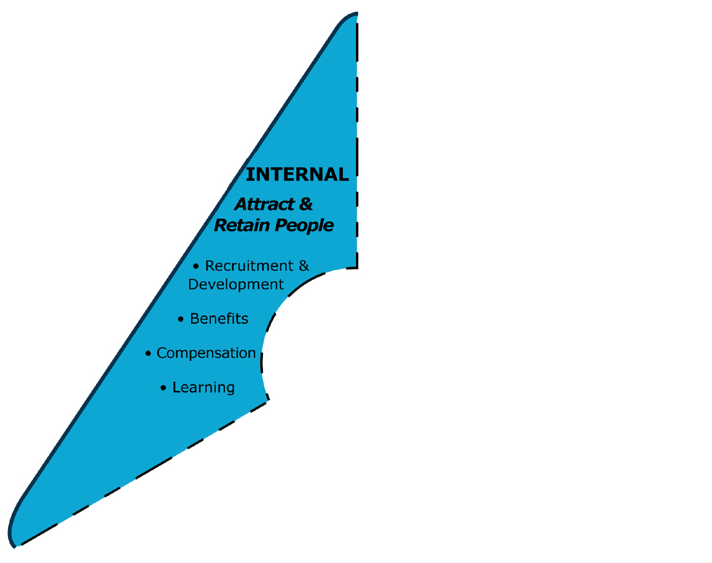
Sample Benchmarks at Level 5 Best Practice
Category 4: Recruitment, Retention, Development and Advancement
Action: Ensure that D&I is integrated into recruitment, talent development, advancement, and retention.
☐ 4.1 The organization’s talent development processes have resulted in equitable and accessible recruitment, retention, and advancement and a pervasive feeling of inclusion.
☐ 4.3 The organization’s reputation for quality D&I efforts enhances its ability to attract and retain employees who contribute to outstanding organizational results.
Notes:
Summary of Category 4:
A conscious effort is made to attract applicants from different diversity dimension groups to achieve and maintain a workforce that shows diversity across levels and functions. Search firms are required to provide diverse candidates. Advertising is targeted to diverse communities, diversity on interviewing panels is standard, and staffing/hiring managers are educated on the impact of bias. High-potential talent from backgrounds not represented in a balanced way across the organization are provided with coaching, mentoring, and sponsorship opportunities. Turnover of underrepresented groups is in parity with that of the majority group.

Slide 52
Sample Benchmarks at Level 5 Best Practice
Category 5: Benefits, Work-Life Integration, and Flexibility
Action: Achieve work-life integration and flexibility.
☐ 5.5 Based on research and assessment, benefits and services are regularly adapted to changing conditions, technology, and innovative ideas.
☐ 5.4 A comprehensive range of flexible benefits and services, including education, health, and counseling, is provided.
Notes:
Summary of Category 5:
Flexible work options are widely available. They are actively promoted and recognized as enhancements of productivity. As such, their use is encouraged and is not seen as career limiting. Benefits and services that are specific to the diverse needs and wants of the employee are provided and updated based on research-driven innovative ideas and on-going assessment of employee needs. Some examples are: subsidized dependent-care, lactation rooms, eldercare, emergency care, fitness programs, and paid leave. Accommodations for religious practices, persons with disabilities, and other special needs are achieved with care and consideration and beyond legal requirements.

Slide 53
Sample Benchmarks at Level 5 Best Practice
Category 6: Job Design, Classification and Compensation
Action: Ensure that job design and classification are
unbiased and compensation is equitable.
☐ 6.3 Inequitable previous compensation systems have been addressed and individuals compensated.
☐ 6.2 Innovative job design results in employees being paid for performance rather than “putting in time,” and enables flexible work options.
Notes:
Summary of Category 6:
The organization systematically reviews job requirements, classifications, and compensation for bias and adverse impact. Job descriptions and requirements are clear and do not include non-job-related factors. The organization designs jobs to accommodate—as much as possible— individual needs as well as organizational needs. Remuneration is based on performance. Compensation analyses are conducted regularly to ensure that biases based on race, ethnicity, age, gender, function, and other potential equity issues are significantly reduced.

Slide 54
Sample Benchmarks at Level 5 Best Practice
Category 7: D&I Learning and Education
Action: Educate leaders and employees so they have
a high level of D&I competence.
☐ 7.1 D&I is integrated into all learning and advances the organization’s strategy.
☐ 7.4 Challenging and sometimes controversial issues such as racism, sexism, ageism, classism, heterosexism, religious bias, stereotype threat, and unconscious bias are effectively addressed with sensitivity, fairness, conviction, and compassion.
☐ 6.3
Notes:
Summary of Category 7:
Leaders and employees throughout the organization receive D&I training that is specific to their area and level and focused on achieving the organization’s goals. Discussion and consideration of D&I issues are integrated into all learning and education programs and events. Programs may focus on either general D&I or specific dimensions of diversity, such as disability, gender identity, sexual orientation, generations, culture, and religion. Issues such as racism, sexism, ageism, classism, heterosexism, prejudice, discrimination, conscious and unconscious bias are addressed with sensitivity, conviction, and compassion.

Slide 55
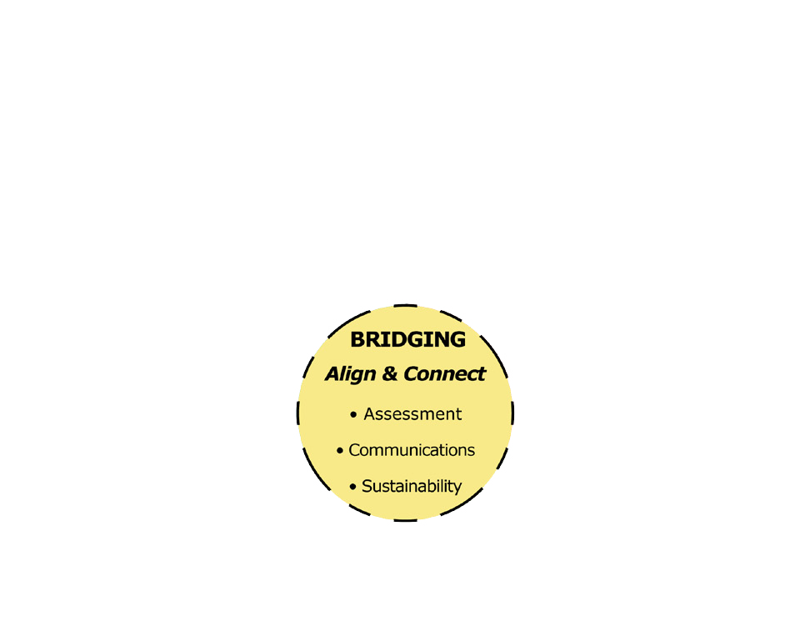
Sample Benchmarks at Level 5 Best Practice
Category 8: Assessment, Measurement, and Research
Action: Ensure that assessment, measurement,
and research guide D&I decisions.
☐ 8.1 In-depth D&I assessments covering behavior, attitude, and perception are regularly conducted for the overall organization and within organizational units and feed into strategy and implementation.
☐ 8.2 D&I measurements are included as part of the organization’s overall performance, linked to the organizational strategy, and tied to compensation, and publically shared.
Notes:
Summary of Category 8:
D&I measures are included in the organization’s reporting processes, are explicitly linked to strategy, and have an impact on leaders’ compensation. The views of stakeholders are a major factor in measuring D&I performance for both the organization and individuals. The measurements include attitudes, opinions and culture, and a mix of quantitative and qualitative measures. Information on all aspects of D&I is gathered and evaluated using such practices as 360-degree feedback, focus groups, and opinion/ engagement surveys. The organization is committed to D&I research.

Slide 56
Sample Benchmarks at Level 5 Best Practice
Category 9: D&I Communications
Action: Make communication a crucial force in
achieving the organization’s D&I goals.
☐ 9.3 D&I communication is frequent, ongoing, innovative, and contributes to an enhanced reputation for the organization.
☐ 9.2 D&I topics are easily and quickly located on the organization’s internal and external websites. Information is thorough, fully accessible, and regularly updated.
Notes:
Summary of Category 9:
Communications professionals are educated about D&I. All internal and external communication is fully accessible and available in multiple formats and languages. D&I topics are easily and quickly located on the organization’s internal and external websites. Information is thorough, fully accessible, and regularly updated. D&I communication is frequent, ongoing, innovative, and contributes to an enhanced reputation for the organization. Progress on reaching D&I vision and goals is reported publicly and regularly.

Slide 57
Sample Benchmarks at Level 5 Best Practice
Category 10: Connecting D&I and Sustainability
Action: Connect the D&I and Sustainability
initiatives to increase the effectiveness of both.
☐ 10.4 The organization has evidence that its sustainability and D&I initiatives benefit from their alignment with each other and show more meaningful impact than if they were separate and unconnected initiatives.
☐ 10.5 D&I results reflect actions in at least three of the following aspects of sustainability as defined by the United Nations−People, Planet, Prosperity, Peace, or Partnership.
Notes:
Summary of Category 10:
The organization connects and aligns D&I and sustainability initiatives. The strategies for each initiative support the other, and many opportunities for collaboration make both initiatives stronger. Leaders and practitioners in sustainability participate in the D&I initiative and vice versa. Both work with various stakeholders and report progress to stakeholders regularly.

Slide 58
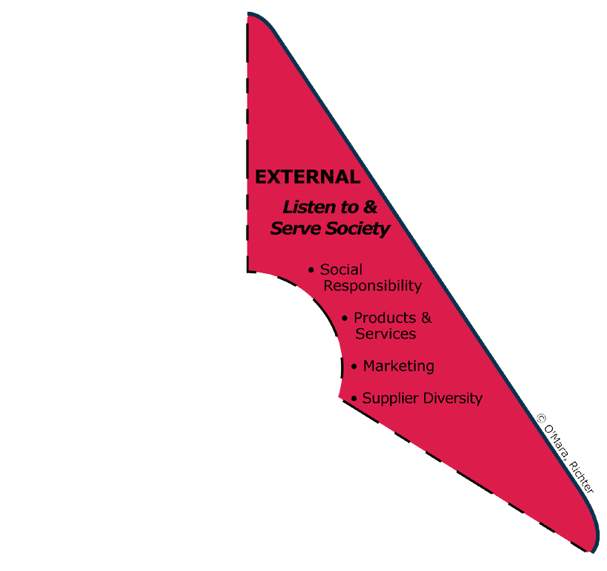
Sample Benchmarks at Level 5 Best Practice
Category 11: Community, Government Relations and Social Responsibility
Action: Advocate for D&I progress within local
communities and society at large.
☐ 11.3 The organization leads in supporting and advocating for diversity-related interests in government and societal affairs.
☐ 11.5 The organization’s D&I initiatives in the community are treated as more than philanthropy. They are perceived as a core function mainstreamed into organizational strategy.
Notes:
Summary of Category 11:
The organization is a recognized leader for supporting and advocating for D&I interests in government and societal affairs aligned with its strategy and objectives. The organization is socially responsible, generous in supporting other organizations in their D&I initiatives, and provides support for the advancement of D&I in the community. Employees are encouraged to participate and support various community projects.

Slide 59
Sample Benchmarks at Level 5 Best Practice
Category 12: Products and Services Development
Action: Embed D&I in products and services development
to serve diverse customers and clients.
☐ 12.1 The product, service, and policy development cycle recognizes diversity and accessibility from the outset. It doesn’t merely adapt products first developed for the dominant group or culture.
☐ 12.3 The organization shows the link between diversity and innovation, consistently leveraging D&I to increase product and service innovation.
Notes:
Summary of Category 12:
D&I considerations are integrated into the product-development cycle to serve diverse groups. Product or service development teams are diverse and include customers, stakeholders, and community representatives. Recognition is also given to the value of D&I in innovation, and the organization consistently leverages D&I for product and service improvement.

Slide 60
Sample Benchmarks at Level 5 Best Practice
Category 13: Marketing and Customer Service
Action: Integrate D&I into marketing and customer service.
☐ 13.2 The organization is keenly aware of the needs, motivations, and perspectives of diverse customer and stakeholder groups and successfully adapts marketing, sales, and distribution strategies to meet these needs.
☐ 13.1 The organization uses sophisticated analysis techniques on an ongoing basis to understand and respond to its diverse customer base.
Notes:
Summary of Category 13:
Marketing and customer service strategies meet the needs of diverse groups. Sophisticated market analysis techniques are deployed on an ongoing basis to understand the organization’s diverse customer base. The organization uses D&I relevant marketing and customer service approaches within and across countries, regions, cultures, and languages. Marketing and advertising are inclusive and challenge stereotypes. While outside D&I expertise may sometimes be sought, the organization leverages the expertise of its diverse staff. All marketing and customer services processes are fully accessible, and accessibility is incorporated into the process of design and development of marketing materials and customer service strategies and processes.

Slide 61
Sample Benchmarks at Level 5 Best Practice
Category 14: Supplier Diversity
Action: Promote and nurture a diverse supplier base
and encourage suppliers to advocate for D&I.
☐ 14.2 The organization’s suppliers reflect the community’s composition across a broad array of diversity dimensions.
☐ 14.1 The organization’s suppliers are required to have a significant percentage of their business with diverse suppliers and to provide evidence that they are committed to achieving their own D&I goals.
Notes:
Summary of Category 14:
Supplier relationships are an integral part of the D&I strategy, and suppliers themselves must commit to achieving D&I goals. The organization’s suppliers reflect the community’s composition across a broad array of diversity dimensions. The organization works with its underrepresented suppliers to improve all aspects of supply management. The supplier diversity function is fully aligned with the broad goals of D&I for the organization. The organization procures both essential and non-essential goods and services from underrepresented suppliers.

Slide 62
Uses of Benchmarks in Your Organization:
To set and stretch standards and agree on your desired state
To assess the current state of D&I
To engage employees
To determine short-term and long-term goals
To measure progress
To assist in hiring D&I staff & consultants
As a “gift” to organizations in your community

Slide 63
Research / Expert Panelists
GDIB represents the collective viewpoints of the Expert Panelists.
Selected by the authors from recommendations based on criteria of breadth and depth in D&I.
Practitioners, scholars, authors from a variety of diversity dimensions, backgrounds, and areas of expertise.
Research process involved several rounds of review and analysis.
Notes:
• The Expert Panelists (EP) were carefully selected by the authors based on their collective experience – many being well-known practitioners, authors, and researchers in the field. Most of the EP are doing comprehensive D&I work in aspects of their environment around the world. A few were added because of their special expertise in compensation, measurement or supplier diversity for example.
• The research is based on the collective opinions of the EP. The research process involved several rounds of review, discussion, editing, and reaching consensus. The authors take responsibility for final decisions made.
• The diversity in background and experience of the EP greatly enhances this collective viewpoint. Some are practitioners, some are scholars, and some are both. They represent a significant array of diversity dimensions as listed earlier in the definition of diversity.
Note to presenter: Be prepared to name a few EP. They are listed in the GDIB. We suggest naming EP that you believe your audience would know and respect most. At times you may be presenting to an audience where one of the EP might be present. Try to determine that in advance and notify the EP that you plan to acknowledge that they are present.

Slide 64
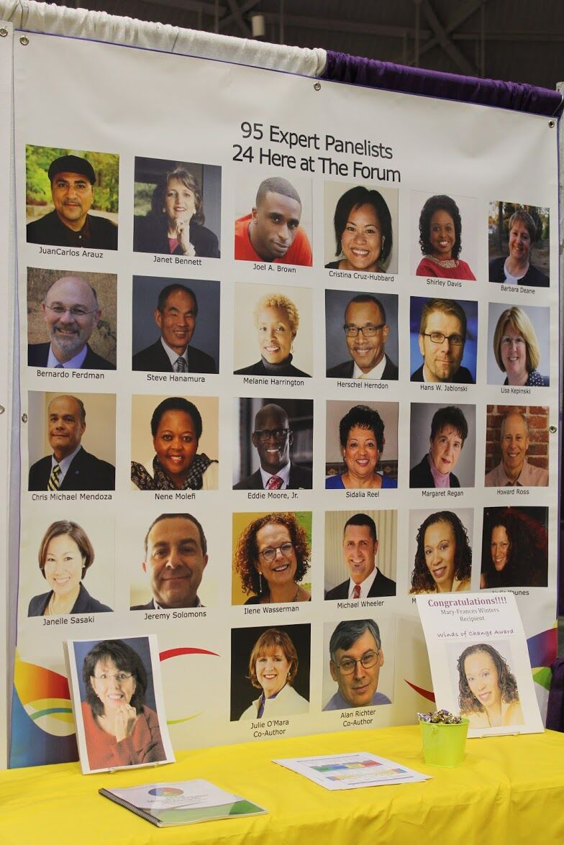

Slide 65
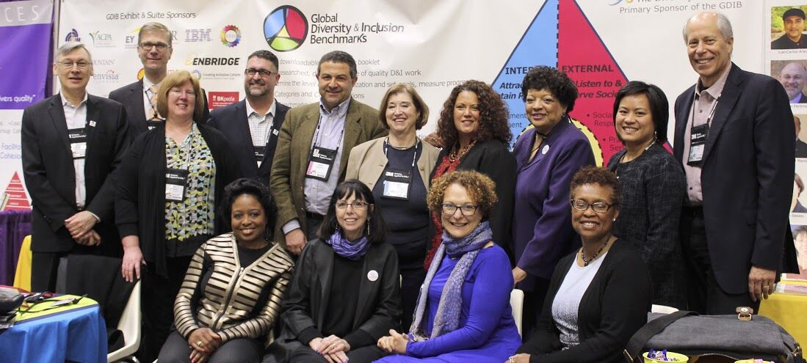
Notes:
Several EP and GDIB Users at the FWI conference. There were about 25 in total. Several others were giving presentations or otherwise occupied when the photo was taken.

Slide 66
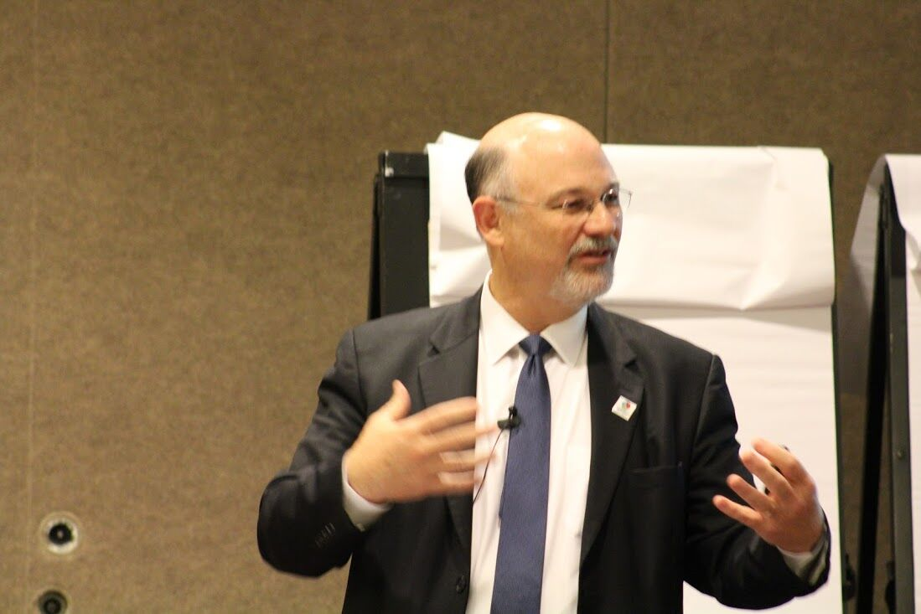
Notes:
EP Bernardo Ferdman.

Slide 67
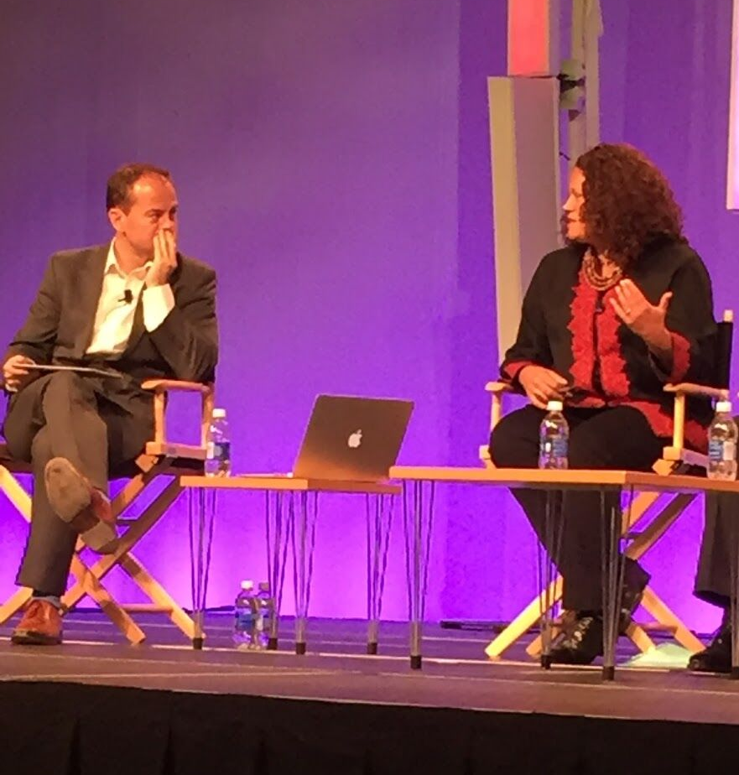
Notes:
EP Nadia Younes with the panel moderator.

Slide 68
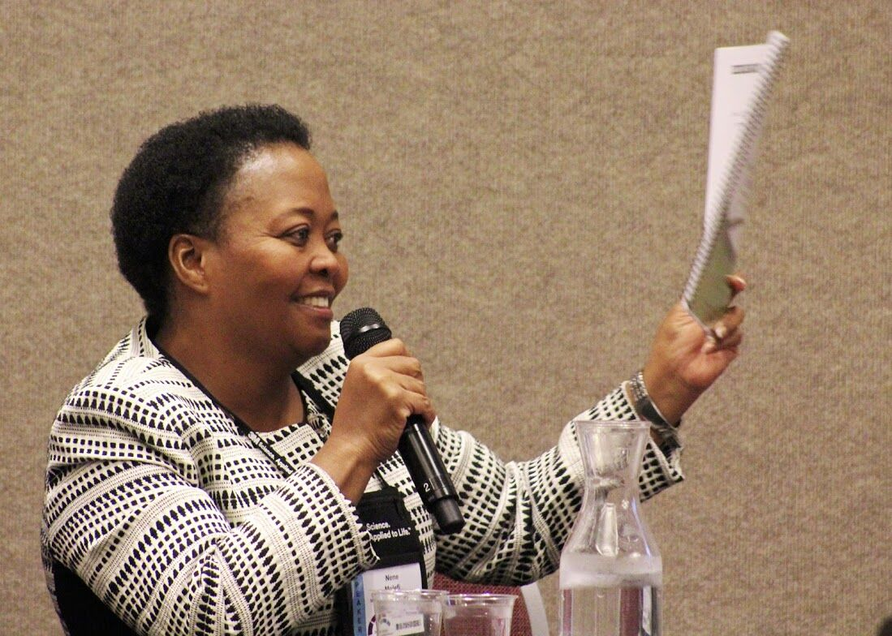
Notes:
EP Nene (pronounced knee-knee) Molefi holding GDIB for all to see.

Slide 69
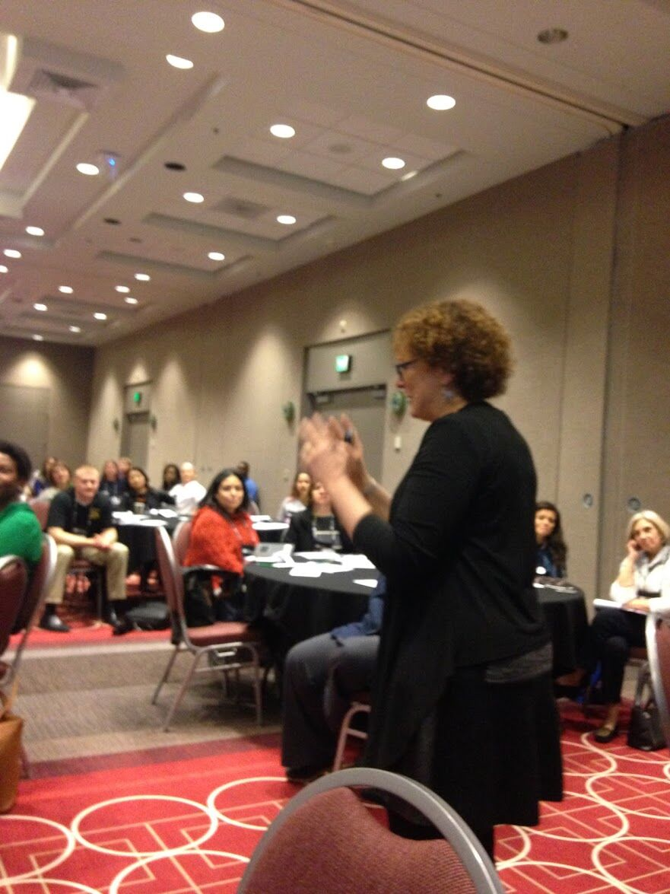
Notes:
EP Ilene Wasserman.

Slide 71
Who is Using the GDIB and What Does “Using” Mean?
• Users in our lexicon are those who have signed the Permission Agreement. Truth is, we can’t keep track.
• But, actually, GDIB is like a book in some ways. People read or skim it and learn from it, but they may not consider that action “using” it.
• What we really want to do is acknowledge best practices… so we don’t care if they are a “user” or not… we want to use GDIB to influence higher levels of best practice.

Slide 72
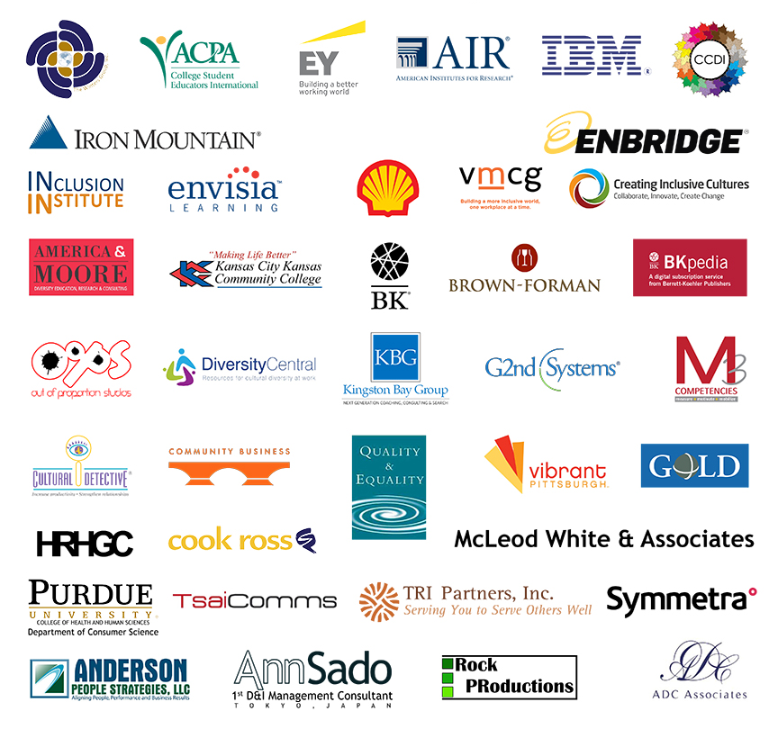
Forum on Workplace Inclusion GDIB, March, 2016
Exhibit and Suite Party Sponsors

Slide 73
Some Users – Permission Granted to Share Best Practice Stories
• Iron Mountain
• IBM (Brussels)
• Her Majesty’s Revenue and Customs (UK)
• Autoliv (Sweden)
• Texas Historical Commission
• UC Berkeley
• Rolls Royce Americas

Slide 74
GDIB Goals
Visibility
Usability
Relevance

Slide 75
Launch Events Coming in 2016
Locally Led -- by EP and Users—
Learning and Celebrations
Planning Underway
• São Paulo
• Washington DC
• Sydney
• Melbourne
• London
• The Netherlands
• Pittsburgh
• Philadelphia
• Seattle
• San Diego
• Los Angeles
• Portland
• Tokyo
• Toronto
• Argentina (webinar)
• New York
• San Francisco/Oakland
• More

Slide 76
For More Information
Visit www.diversitycollegium.org
Navigate to Global D&I Benchmarks
Notes:
• The Diversity Collegium is a group of 25 professionals that has been meeting for more than two decades for the purpose of advancing the work that has come to be known as the field of Diversity and Inclusion.
• Its mission is to advance the field of D&I though dialogues, symposia, research, and publications.
• The Collegium members meet face-to-face twice a year to discuss current issues in the field. They conduct research and prepare papers on current and cutting edge questions.
• Membership in the group is by invitation only and is managed so that a balance of diversity is created among its members including such dimensions as race/ethnicity, industry, gender, and how one practices in the field.
• In late 2013 the membership voted to sponsor GDIB.

Slide 77
Use and Permissions
Global Diversity and Inclusion Benchmarks (GDIB) is distributed as a PDF document. Permission to use this tool will be granted at no cost by signing an agreement with the authors.
To download the GDIB, for the Permissions Agreement, and additional tools and resources, go to:
www.diversitycollegium.org
Julie O’Mara Alan Richter
+ 1-702-541-8920 + 1-212-724-2833
julie@omaraassoc.com alanrichter@qedconsulting.com
www.omaraassoc.com www.qedconsulting.com
Notes:
The goal of the authors, the Expert Panelists, and The Diversity Collegium is to see the Benchmarks used as a tool to increase the quality of diversity and inclusion work.
Global Diversity and Inclusion Benchmarks: Standards for Organizations Around the World is meant to be shared. Please distribute widely. You are encouraged to forward it to others around the world. You may do that without asking permission.
However, because The Diversity Collegium and the authors want to ensure appropriate and consistent use and track and engage users for the purposes of continuous improvement, you are required to get permission to put it on your website or use it in any way.
And they also ask you to keep them posted on how you are using the GDIB and to offer suggestions for updates or additional tools that would help you.
We wish you well in advancing the quality of D&I work around the world.
.

