Slide 1

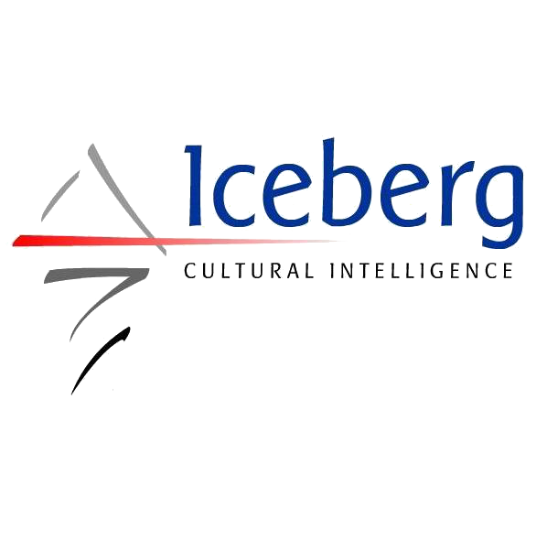
¿Qué es “diversidad” para tí?
Pronto estaremos iniciando el webinar

Slide 2
Global Diversity and Inclusion Benchmarks: Standards for Organizations Around the World
By Julie O’Mara, Alan Richter, and 95 Expert Panelists

Slide 3
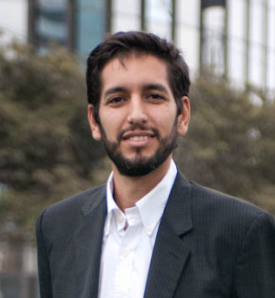
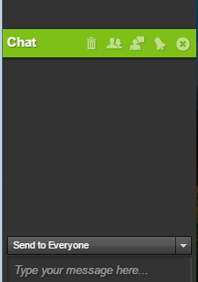
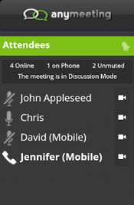
Marcelo Baudino
Moderador
ICEBERG Inteligencia Cultural
¡Participa con tus preguntas y comentarios!

Slide 4

Hashtag y materiales de apoyo
@icebergci
#GDIB

Slide 5

Shirley Saenz
Expert panelist GDIB 2016
Consultora y formadora intercultural
Iceberg Cultural Intelligence
Notes:
(copy from GDIB pages to use to speak to this slide)
We offer the Global Diversity & Inclusion Benchmarks: Standards for Organizations Around the World (GDIB) to support organizations globally in the development and implementation of Diversity and Inclusion (D&I) best practices.
The GDIB helps organizations:
Realize the depth, breadth, and integrated scope of D&I practices;
Assess the current state of D&I;
Determine strategy, and;
Measure progress in managing diversity and fostering inclusion.
Diversity and Inclusion has emerged as a worldwide practice that is critical to an organization’s success. As with other disciplines, such as quality and safety, standards are needed to establish criteria by which to measure and monitor progress.

Slide 6

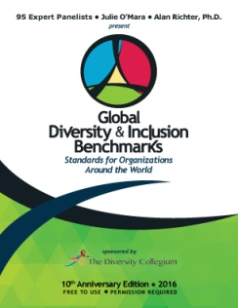


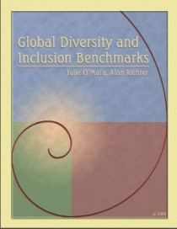

2016
Tenth Anniversary Edition
Co-Authors & 95 Expert Panelists
2014
GDIB
Co-Authors &
80 Expert Panelists
2011
GDIB
Co-Authors & 79 Expert Panelists
2006
GDIB
Co-Authors &
47 Expert Panelists
1993
Bench Marks for Diversity
Tennessee Valley Authority
La evolución del GDIB
Notes:
FOR TIMELINE: Although it began in Western cultural perspective (1993), GDIB has been revised, adapted, and expanded now 4 times to incorporate a global mindset: Evolution of GDIB has been a dynamic global process

Slide 7

Un trabajo exhaustivo
“The Diversity Collegium se complace en patrocinar los GBDI por ser una herramienta que explica lo que implica la creación de sistemas inclusivos y la gestión de la diversidad, representando las mejores ideas y pensamientos de 95 expertos alrededor del mundo. Lo más importante es que es gratuito y puede ser utilizado por cualquier persona u organización”
Notes:
Our main sponsor is The Diversity Collegium. And much information about the GDIB is found on its website. You’ll see a slide at the end with the URL.
Having the support of the Diversity Collegium is significant because it is a group of seasoned professionals. Most Collegium active and emeritus members are Expert Panelists.
Grupo de 25 académicos, profesionales y líderes dedicados a investigar y reflexionar sobre la diversidad
Se reúnen desde hace de más de 2 décadas
Misión: Promover los avances en el campo de la D&I a través de diálogos, coloquios, investigaciones y publicaciones
Janet Bennet, Donna Stringer
Julie O mara y Alan – reconocida por el Global Diversity List en el TOP 50 de los profesionales de diversidad en el mundo

Slide 8
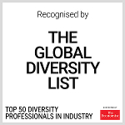
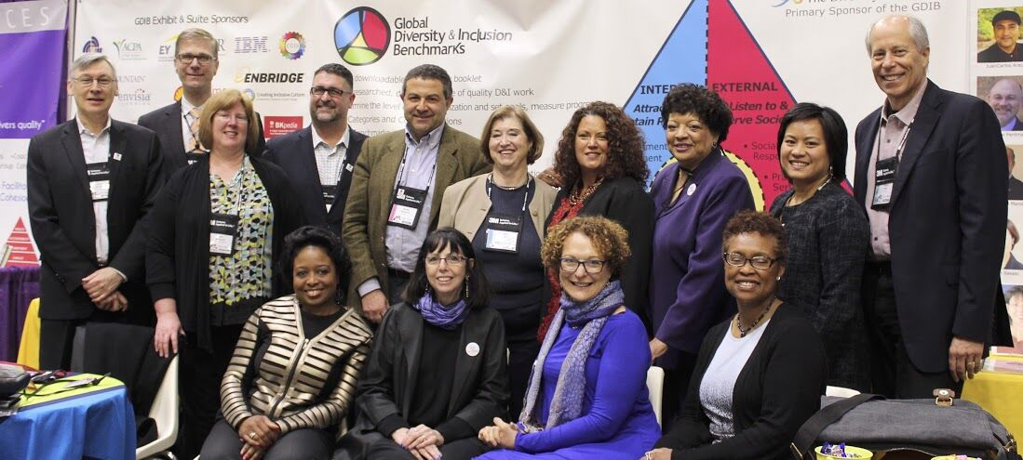
Forum on Workplace Inclusion GDIB
Marzo, 2016
Julie O’Mara, Alan Richter, y algunos de los panelistas
Notes:
Several EP and GDIB Users at the FWI conference. There were about 25 in total. Several others were giving presentations or otherwise occupied when the photo was taken.

Slide 9
¿Qué es un benchmark?
Notes:
Una pauta organizacional de desempeño,
usualmente expresada como un fin o resultado.
El Benchmarking ayuda a las personas en las organizaciones a tener aspiraciones y resultados de alta calidad
• Synonyms for the word benchmark, as we use it in GDIB, include standard, milestone, yardstick, and criterion for success.
• Usually an organization sets annual goals designed to move steadily toward reaching higher benchmarks. It may take several years and many activities to achieve the highest level benchmarks.
• Once a benchmark is reached, the organization must be committed to maintaining that standard in the years to come – or it may set even higher standards.
• Benchmarks at the highest levels are called best practices. In GDIB they are those at Level 5.
• Because organizations are different types and sizes and in different sectors and sometimes locations, the specific benchmarks will vary for each organization. Therefore the Global Diversity and Inclusion Benchmarks may need to be adjusted given your specific organization.
• We should mention competencies in this discussion. They are not the same as benchmarks. Competencies are important markers to assure that quality work is done. Competencies are the skills, knowledge, and ability that people need to achieve the benchmarks.

Slide 10
Los GDIB contribuyen a asegurar que el trabajo para la diversidad y la inclusión se lleve a cabo con el más alto nivel de calidad posible
Notes:
• The goal for publishing these Benchmarks is to encourage high-quality work in the D&I field, regardless of type of organization or where located.
• Sometimes people in organizations think that diversity and inclusion refers only to how well people get along and/or how much people know about customs and cultures and holidays.
• But high-quality diversity and inclusion can deliver organizational results:
that spark the development of innovative products and services and give the organization a competitive advantage,
that strengthen collaboration which results in smoother operations,
that literally saves lives in some healthcare instances where differences in beliefs can have negative consequences,
that inspire peace building in communities, and
that foster environments where people are retained and able to work at their full capacity.

Slide 11
¿Cuenta tu organización con un programa de Diversidad & Inclusión?
No / No lo sé
Se implementan algunas iniciativas aisladas
Estamos diseñando o poniendo en marcha un programa integrado de D&I
Existe un programa estratégico de D&I en toda la organización en implementación

Slide 12
Los GDIB ayudan a las organizaciones a:
Darse cuenta de la profundidad, amplitud y alcance de las prácticas integradas de D&I;
Evaluar el estado actual de la D&I en la compañía;
Determinar objetivos y estrategias para el corto y largo plazo;
Medir los avances en la gestión de la diversidad e inclusión.
Notes:
(copy from GDIB pages to use to speak to this slide)
We offer the Global Diversity & Inclusion Benchmarks: Standards for Organizations Around the World (GDIB) to support organizations globally in the development and implementation of Diversity and Inclusion (D&I) best practices.
The GDIB helps organizations:
Realize the depth, breadth, and integrated scope of D&I practices;
Assess the current state of D&I;
Determine strategy, and;
Measure progress in managing diversity and fostering inclusion.
Diversity and Inclusion has emerged as a worldwide practice that is critical to an organization’s success. As with other disciplines, such as quality and safety, standards are needed to establish criteria by which to measure and monitor progress.

Slide 13
Agenda
1. Las bases
Objetivos GDIB
2. Características
El modelo
Los niveles de medición
3. Los bechmarks
Ejemplos
Usos y permisos
Enfoques hacia la D&I
La investigación
Aplicaciones
Definiciones

Slide 14

1. Las bases
@icebergci
#GDIB

Slide 15

Objetivos fundamentales de la Diversidad & Inclusión
Crear un mundo mejor
Mejorar el desempeño organizacional
Notes:
Contribute to the greater good of society
Create a world which is fair and just and respectful of individuals and their similarities and differences
Create a world where everyone is able to sustain a high quality of life and enjoy peace and prosperity

Slide 16
Una estrategia de D&I bien diseñada y ejecutada puede ayudar a una organización a:
Lograr su visión, misión, estrategia y objetivos
Atraer y retener al talento diverso
Construir equipos de alto desempeño
Desarrollar líderes que inspiren comportamientos inclusivos y defiendan la diversidad
Mejorar la creatividad, innovación y resolución de problemas
Incrementar el compromiso la motivación y la creatividad
Mejorar el balance de vida y trabajo
Mejorar la reputación de la organización
Notes:
No additional copy.

Slide 17
Diversidad
La variedad de diferencias y similitudes entre las personas en dimensiones tales como:
  Edad
  Sistema de creencias
  Clase social
  Cultura
  Dispacidad
  Educación
  Etnia
  Género
  Identidad de género
  Generación
  Geografía
  Función y rol en el trabajo
  Lenguaje
  Estado civil
  Salud mental
  Nacionalidad
  Origen nativo o indígena
  Estado parental
  Tipo de personalidad
  Raza
  Religión
  Orientación sexual
  Estilo de pensamiento
  Experiencia de trabajo
  Estilo de trabajo
Notes:
There are three important definitions to know to fully understand Global Diversity and Inclusion Benchmarks: diversity, inclusion, and global.
• All three of these definitions were agreed to by the Expert Panelists (more on them later). You will find – literally – thousands of definitions of diversity and inclusion as well on the Internet. However, this definition has been agreed to by the Expert Panelists, so it is a pretty solid definition worth using.
• Diversity is the wide variety of differences and similarities – referred to as dimensions – among people.
• Listed here are some of the key dimensions.

Slide 18
Inclusión
Un estado dinámico de funcionamiento en el que la diversidad se aprovecha para crear una organización o comunidad justa, saludable y de alto rendimiento.
Un ambiente inclusivo asegura un acceso equitativo a los recursos y oportunidades para todos. También permite a los individuos y grupos sentirse seguros, respetados, comprometidos, motivados y valorados por lo que son y por sus contribuciones a los objetivos de la organización.
Notes:
The term inclusion has been described by practitioners and scholars in several different ways.
In Global D&I Benchmarks the important quality of inclusion is that it helps create a fair, equitable, healthy, and high-performing organization or community.
And in that organization or community, people are valued.
These are the end-goals.

Slide 19
Definición y alcance global
Estos benchmarks son aplicables a todas las organizaciones de todo el mundo.
No se limitan a las organizaciones multinacionales que trabajan a nivel internacional.
No son específicos de un país, cultura, enfoque que D&I, sector, industria o tamaño de la organización.
Notes:
• For Global D&I Benchmarks, the definition of global simply means that these Benchmarks can be used around the world by all organizations and communities.
• These benchmarks are not just for organizations that have customers or locations around the world. They apply to all organizations no matter where they are located.

Slide 20

Competencia
Justicia social
Compliance
Dignidad
Desarrollo organizacional
Enfoques hacia la Diversidad & Inclusión
Notes:
Numerous approaches to D&I. We’ve identified 5, not to say all must follow or agree to them…BUT to state that they exist. The GDIB provides more extensive descriptors and terminology often used within these 5 umbrella approaches.
Important to highlight 3 things:
There is much overlap among the 5 approaches
The approaches operate as a system (work and progress in one approach quite probably impacts another approach)
We NOTE: Descriptors may have different meanings in different cultures and language translations may alter the meaning of specific words.
NOTE TO PRESENTERS: See copy in the GDIB. 5 slides follow – each with more information on one approach.

Slide 21
2. Características
@icebergci
#GDIB
Notes:
Contribute to the greater good of society
Create a world which is fair and just and respectful of individuals and their similarities and differences
Create a world where everyone is able to sustain a high quality of life and enjoy peace and prosperity

Slide 22
Investigación/Panel de expertos
Los GDIB representan la opinión colectiva del panel de expertos
Seleccionados por los autores en base a recomendaciones y conocimientos y/o experiencia en el campo de la D&I.
Profesionales, académicos y autores de una gran variedad de dimensiones de la diversidad, áreas de experiencia y antecedentes
El proceso de investigación incluye varias rondas de revisión y análisis

Slide 23

Un trabajo efectivo en D&I se logra cuando:
es estratégico,
está atado a la misión y objetivos de la organización,
se conduce con competencia y cuidado, y
se implementa se manera sostenible.
Lynda White
Former-President of The Diversity Collegium
Notes:
This quote appeared in the press release to announce the 2016 GDIB. May 29, 2016.
At that time Lynda White was president. As of June 1, Michael Wheeler is president and Lynda is Past President.

Slide 24


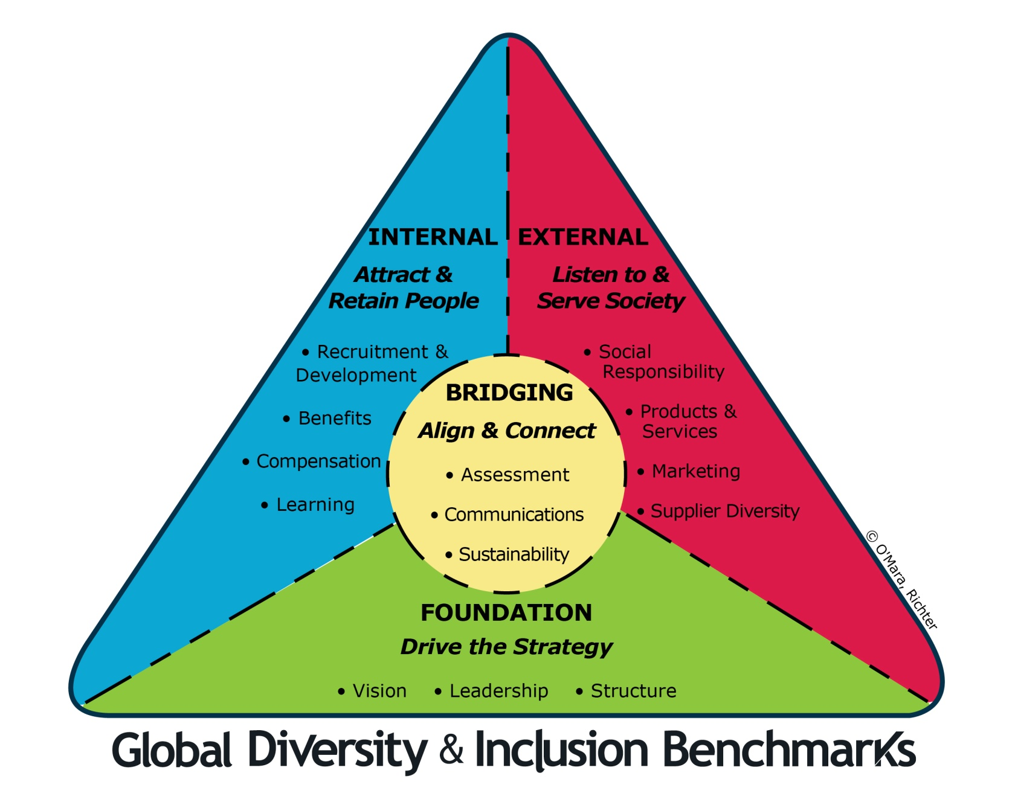
The GDIB Model
4 grupos
14 categorías
266 benchmaks
Notes:
4 áreas primarias de trabajo:
Impulsar la estrategia
Alinear y conectar
Escuchar y servir a la sociedad
Atraer y retener talento
14 acciones concretas
266 Benchmarks. En promedio 19 por cada acción
The logo is a stylized version of the new GDIB Model.
It is set in a circle to convey the ongoing and never-ending importance of diversity and inclusion.
The equilateral triangle in the center symbolizes equality and solidarity or strength and represents the Bridging Group.
Colors have a wide range of meaning across cultures. What may be interpreted as a positive meaning for one color in one culture may be a nearly opposite meaning in another culture. We have been thoughtful in our selection of colors and offer our interpretation, which is a combination of a various cultural symbolism. The color yellow was selected for Bridging because it stands for optimism and imagination. The green color for the Foundation Group symbolizes nature and renewal, blue for the Internal Group represents harmony and order, and red for the External Group stands for passion and strength. All are in a vibrant hue, which symbolizes the vitality to succeed.
The swirls of dark blue represent the power, energy, and motion needed to sustain this work.
And the openness of the swirls showing the colors overlapping one another symbolizes the integration and comprehensiveness needed for D&I to succeed.

Slide 25
14 Categorías en 4 grupos
Fundamentos
Para impulsar la estrategia
Tendiendo puentes
Para alinear y conectar
Visión, estrategia y business case para D&I
Liderazgo and responsabilidad
Infraestructura e implementación
Evaluación, Medición e investigación
Comunicaciones de D&I
Conectando D&I y sostenibilidad
Nivel interno
Para atraer y retener talento
Nivel externo
Para escuchar y servir a la sociedad
Reclutamiento, desarrollo y avance de carrera
Beneficios, integración vida laboral y personal, y flexibilidad
Diseño del trabajo, clasificación y remuneración
Educación y entrenamiento en D&I
  Comunidad, Relaciones con el gobierno, y Responsabilidad Social
  Desarrollo de productos y servicios
  Marketing, ventas, distribución y Servicio al cliente
  Diversidad de proveedores
Notes:
• Foundation Benchmarks are those used initially and throughout to build and sustain a D&I initiative.
• Internal Benchmarks focus on systems and processes that strengthen how the organization operates and how the effectiveness of people is increased.
• Bridging Benchmarks are critical linkages that bridge foundational work with the internal and external focus of D&I in the organization.
• External Benchmarks relate to how the organization offers its products and services and interacts with its customers and other stakeholders.
Let me give you two examples of what we mean by D&I working as a comprehensive system.
Example 1 of operating as a system: For recruitment (Internal) to be successful, the organization must have excellent relationships with the community (External), and communications efforts (bridging) both inside and outside the organization need to strong.
Example 2 of operating as a system: Customer Service (External) will be enhanced with excellent D&I education and training (Internal) that is reinforced when leaders are held accountable (Foundation) for the relevance and effectiveness of the training.
For most organizations work will need to be done in all categories simultaneously as activities must reinforce each other. The groups and categories are not sequential – you don’t start with one, then go to two and three and so forth. The benchmarks in various categories interact to support or reinforce each other.

Slide 26

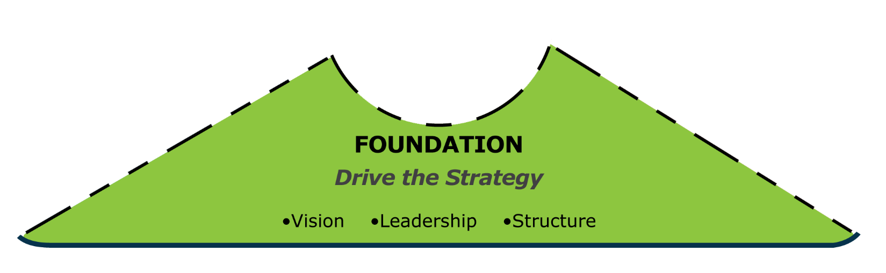
GDIB Acciones - Impulsar la estrategia
Desarrollar una sólida justificación para la visión y la estrategia de D&I y alinearla con los objetivos organizacionales.
Responsabilizar a los líderes por la implementación de la visión de D&I en la organización, estableciendo objetivos, logrando resultados y siendo modelos a seguir.
Proporcionar una estructura de soporte que tenga la autoridad y el presupuesto para implementar efectivamente las iniciativas de D&I.
Los fundamentos

Slide 27

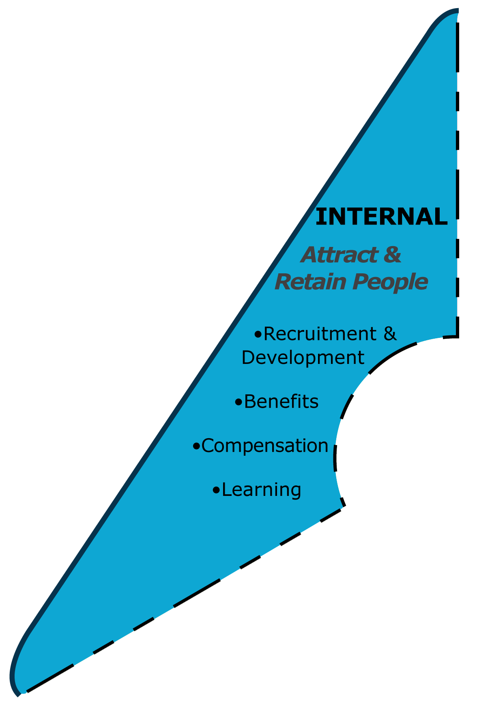
GDIB Acciones - Atraer & Retener talento
Asegurar que la D&I está integrada en los procesos de reclutamiento, desarrollo de talento, promoción, y retención.
Lograr flexibilidad laboral y e integración de la vida laboral y personal.
Asegurar que el diseño y clasificación de puestos estén libres de sesgos y que la compensación sea equitativa
Educar a los líderes y empleados para que tengan un alto nivel de competencia en D&I.
Nivel interno

Slide 28

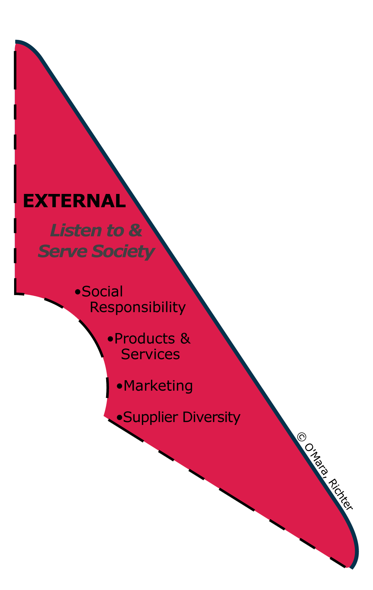
GDIB Actions – Escuchar y servir a la sociedad
Promover avances de D&I dentro de la comunidad local y la sociedad en su conjunto.
Incluir prácticas de D&I en el desarrollo de productos y servicios para atender a clientes diversos.
Integrar a la D&I en los procesos de marketing y servicio al cliente.
Promover y consolidar una base de proveedores diversa y alentar a los proveedores para avanzar en D&I
NIVEL EXTERNO

Slide 29

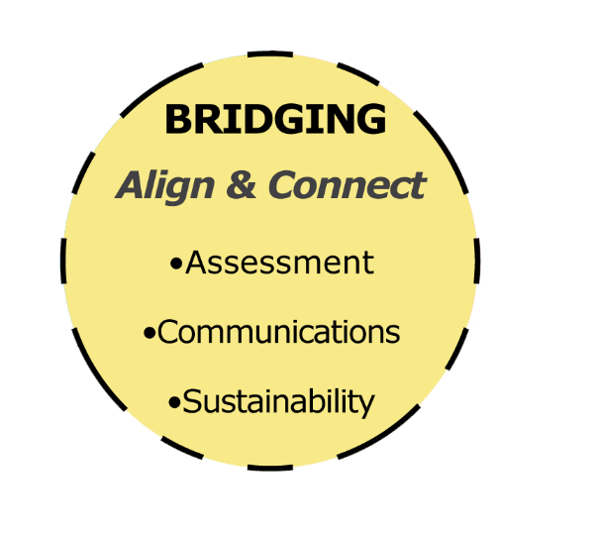
GDIB Actions – Alinear y conectar
Asegurar que las decisiones de D&I se basen en evaluaciones, mediciones e investigaciones.
Hacer de la comunicación una fuerza fundamental para el logro de las metas de D&I de la organización.
Conectar las iniciativas de diversidad con las de sostenibilidad para aumentar la eficacia de ambas.
TENDIENDO PUENTES

Slide 30
The GDIB Model
4 grupos
14 categorías
266 benchmaks
Notes:
The logo is a stylized version of the new GDIB Model.
It is set in a circle to convey the ongoing and never-ending importance of diversity and inclusion.
The equilateral triangle in the center symbolizes equality and solidarity or strength and represents the Bridging Group.
Colors have a wide range of meaning across cultures. What may be interpreted as a positive meaning for one color in one culture may be a nearly opposite meaning in another culture. We have been thoughtful in our selection of colors and offer our interpretation, which is a combination of a various cultural symbolism. The color yellow was selected for Bridging because it stands for optimism and imagination. The green color for the Foundation Group symbolizes nature and renewal, blue for the Internal Group represents harmony and order, and red for the External Group stands for passion and strength. All are in a vibrant hue, which symbolizes the vitality to succeed.
The swirls of dark blue represent the power, energy, and motion needed to sustain this work.
And the openness of the swirls showing the colors overlapping one another symbolizes the integration and comprehensiveness needed for D&I to succeed.

Slide 31
CINCO NIVELES DE PROGRESO
BEST PRACTICE
    Se demuestran las mejores prácticas actuales en D&I; ejemplo para otras organizaciones a nivel mundial.
5
PROGRESIVO
  Implementación sistemática de D&I; muestra mejora en los resultados
4
PROACTIVO
  Consciencia clara de la importancia de la D&I; empezando a implementar programas de D&I de manera sistémica.
3
REACTIVO
  Mentalidad de cumplimiento con la ley: acciones implementadas en respuesta a la normatividad o presiones sociales
2
INACTIVO
  No se ha iniciado ningun trabajo en D&I; ni la diversidad no una cultura de inclusión hacen parte de los objetivos organizacionales
1

Slide 32
3. Los benchmarks
@icebergci
#GDIB
Notes:
Contribute to the greater good of society
Create a world which is fair and just and respectful of individuals and their similarities and differences
Create a world where everyone is able to sustain a high quality of life and enjoy peace and prosperity

Slide 33
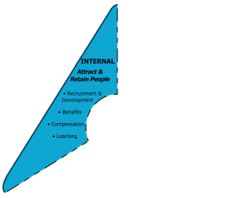
CATEGORIA 4: RECLUTAMIENTO, RETENCIÓN, DESARROLLO, Y PROMOCIÓN
Nivel 1: Inactivo
Nivel 2: Reactivo
Nivel 3: Proactivo
Nivel 4: Progresivo
Nivel 5: Best practice
No hay ningún esfuerzo para reclutar, seleccionar o retener talento de grupos diversos subrepresentados en los diferentes niveles de la organización.
Los sistemas de desarrollo y crecimiento no se centran en la inclusión de diversos candidatos.
Los gerentes están educados en la comprensión de las diferencias y el impacto que sus sesgos pueden tener sobre las decisiones de selección, desarrollo y promoción.
Se anima a los empleados a considerar oportunidades de desarrollo y posiciones fuera de su área funcional, técnica o profesional actual.
La rotación de los miembros de los grupos menos representados está en paridad con la del grupo mayoritario

Slide 34
CATEGORIA 4: RECLUTAMIENTO, RETENCIÓN, DESARROLLO, Y PROMOCIÓN
“Los esfuerzos para atraer mujeres continúan una vez que se unen” – Credit Suisse India
Un programa de 12 meses dirigido a las mujeres de alto potencial en la compañía y a sus gerentes
Un programa de mentoring global de 2 años entre miembros del comité directivo y mujeres de alto potencial
Una red activa dónde las mujeres líderes puedan inspirar y compartir sus experiencias personales
Resultado:
Retención de mujeres 80%
Retención de hombres 70%
Notes:
EFFORTS TO ATTRACT WOMEN DO NOT STOP ONCE THEY JOIN Credit Suisse, India, shows retention results of female college graduates “Over the past three years, Credit Suisse, a global financial services company, has tracked its retention rates. It has found that it has been able to retain 80 to 85 percent of women hired through campus recruitment in comparison to 70 percent of their male hires … The efforts to attract women do not stop once they join our organization. We have a number of programs designed for female talent including: è A 12-month programmed targeting high potential women employees and their managers to address gender-based myths that exist not just in the minds of women employees but also their managers. è A two-year global mentoring programme for women where high-potential women are mentored by an executive board member to support them in navigating their careers. è An active women’s Network where inspiring women leaders share their personal journeys.” Story shared by Vedika Bhandarkar, Vice Chairman and Managing Director. From Building the Business Case for Diversity and Inclusion: Stories from India. Sponsored by DIAN, Diversity & Inclusion in Asia Network, part of Community Business. GDIB Expert Panelist Kate Vernon is director of Strategic Programmes.
þ 4.11 (GDIB Category 4:Recruitment, Retention, Development, and Advancement). Benchmark at Level 4 – High potential talent is provided with internal coaches, mentors, and external coaching opportunities to maximize performance and develop advanced careers. and þ 7.4 (GDIB Category 7: D&I Learning and Education). Benchmark at Level 5 – Challenging and sometimes controversial issues such as racism, sexism, ageism, classism, heterosexism, religious bias, stereotype threat, and unconscious bias are effectively address with sensitivity, fairness, conviction and compassion.

Slide 35
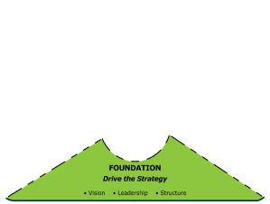
CATEGORIA 1: VISIÓN, ESTRATEGIA Y BUSINESS CASE PARA D&I
Nivel 1: Inactivo
Nivel 2: Reactivo
Nivel 3: Proactivo
Nivel 4: Progresivo
Nivel 5: Best practice
No hay una visión de D&I, estrategia,, business case, objetivos, políticas, principios, ni programas.
La D&I tiene una definición limitada refiriéndose sólo a algunos grupos no representados. La atención se centra principalmente en las cuotas en los diferentes niveles de la organización.
La organización ha examinado su sistemas, prácticas, requerimientos, y cultura, y ha creado estrategias para reducir las barreras a la inclusión.
La mayoría de los stakeholders reconocen que la D&I es importante para contribuir al éxito de la organización.
La estrategia de D&I contribuye a resultados específicas y el éxito general de la organización en formas observables y medibles.

Slide 36
Algunos usuarios del GDIB
• Iron Mountain
• IBM (Brussels)
• Her Majesty’s Revenue and Customs (UK)
• Autoliv (Sweden)
• Texas Historical Commission
• UC Berkeley
• Rolls Royce Americas
Boehringer Ingelheim
FMI

Slide 37
Uso y permisos
Los Global Diversity and Inclusion Benchmarks (GDIB) se distribuyen en un documento formato PDF. El permiso para utilizar los GDIB se otorga sin costo mediante la firma de un acuerdo con los autores.
Para descargar el GDIB, el acuerdo de uso y obtener recursos adicionales, visita: www.diversitycollegium.org
Julie O’Mara
+ 1-702-541-8920
julie@omaraassoc.com
www.omaraassoc.com
Alan Richter
+ 1-212-724-2833
alanrichter@qedconsulting.com
www.qedconsulting.com
Shirley Saenz
+ 54 9 11 5734 3849
ssaenz@icebergci.com
www.icebergci.com
Notes:
The goal of the authors, the Expert Panelists, and The Diversity Collegium is to see the Benchmarks used as a tool to increase the quality of diversity and inclusion work.
Global Diversity and Inclusion Benchmarks: Standards for Organizations Around the World is meant to be shared. Please distribute widely. You are encouraged to forward it to others around the world. You may do that without asking permission.
However, because The Diversity Collegium and the authors want to ensure appropriate and consistent use and track and engage users for the purposes of continuous improvement, you are required to get permission to put it on your website or use it in any way.
And they also ask you to keep them posted on how you are using the GDIB and to offer suggestions for updates or additional tools that would help you.
We wish you well in advancing the quality of D&I work around the world.
.

Slide 38
¿Preguntas?
@icebergci
#GDIB

Slide 39


www.icebergci.com
www.bloginteligenciacultural.com
@icebergci
info@icebergci.com

